Slide 1
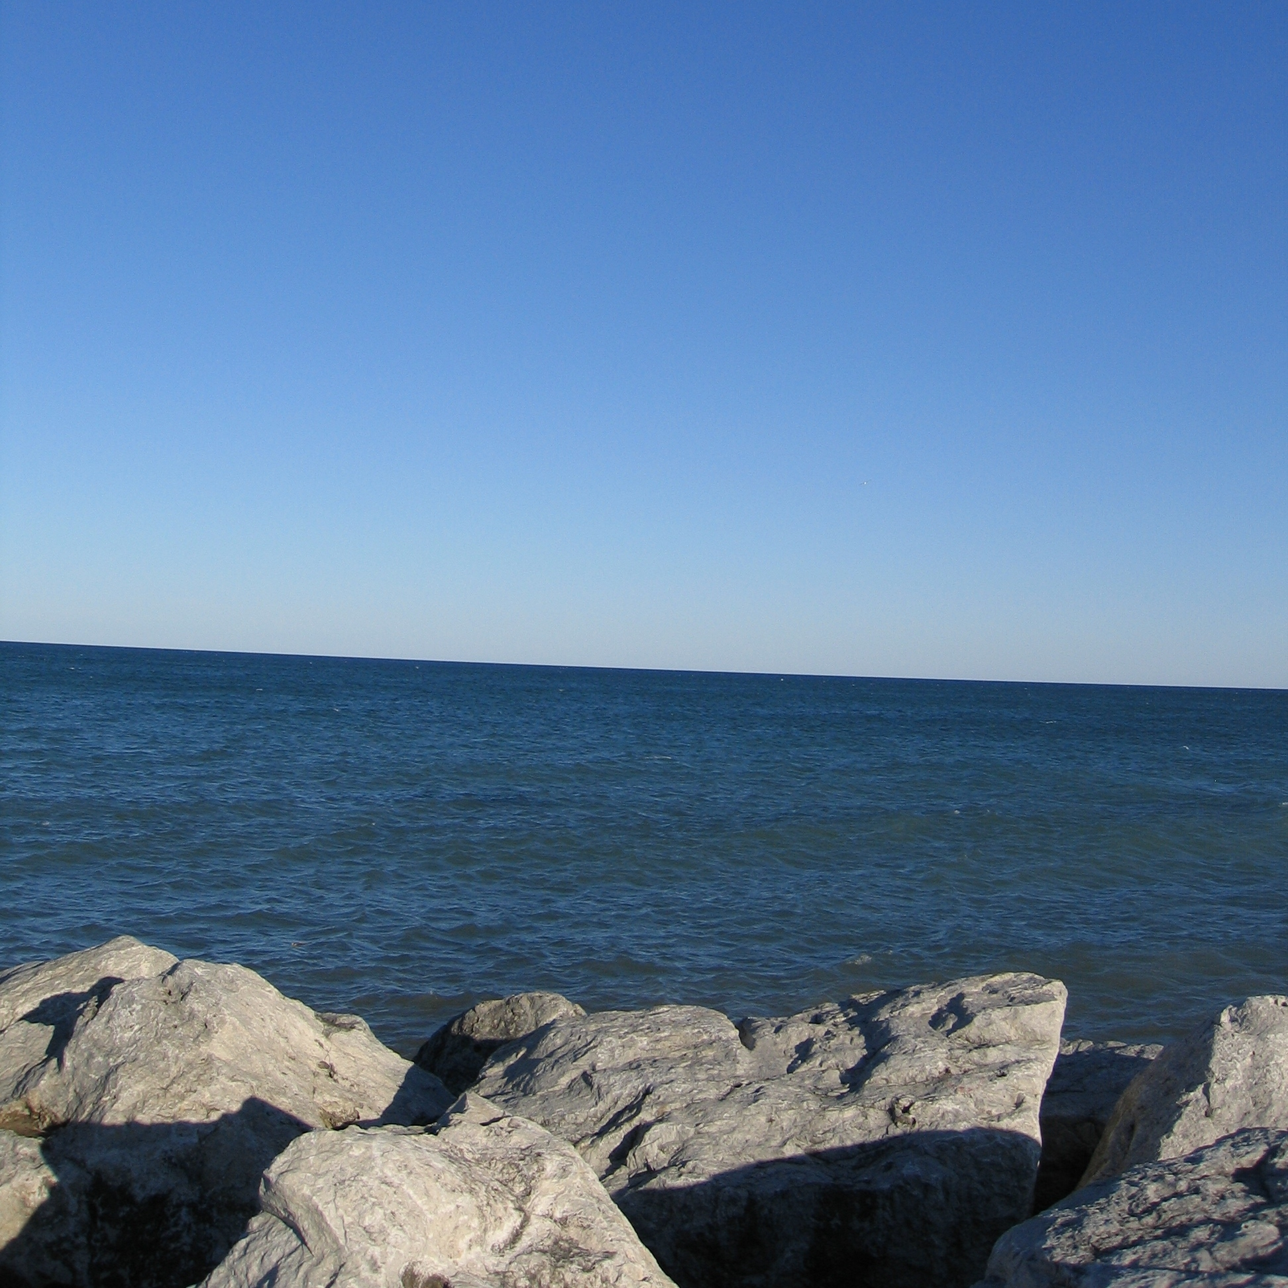
School of Freshwater Sciences:
Research important for freshwater systems
Training the next generation of water scientists
Rebecca Klaper, Ph.D.
Professor and Vice Dean

Slide 2
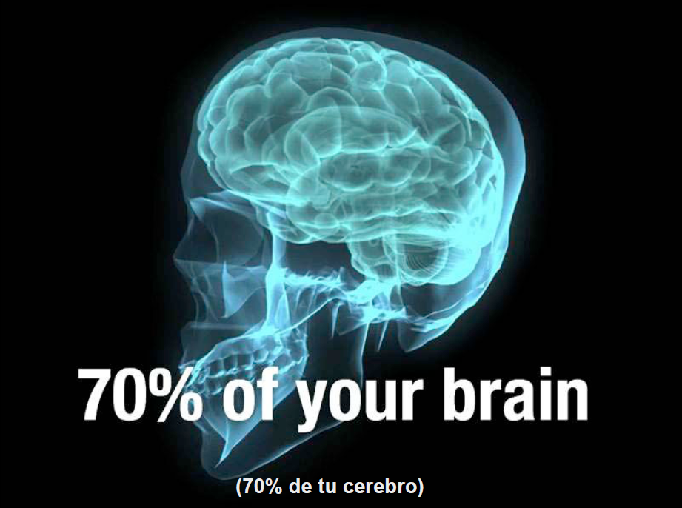
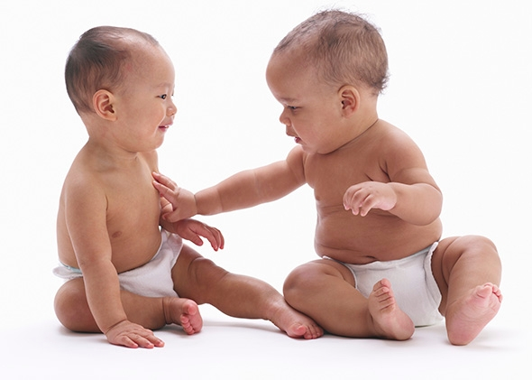

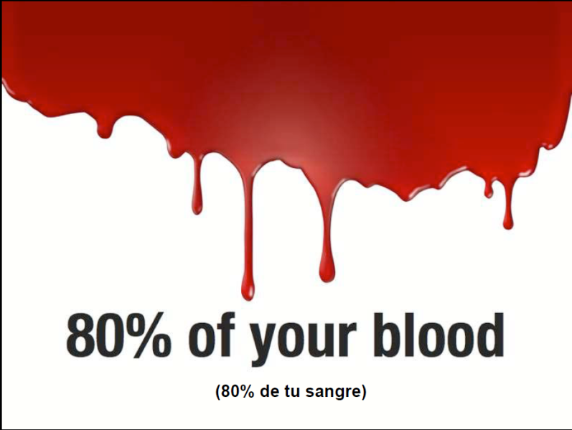
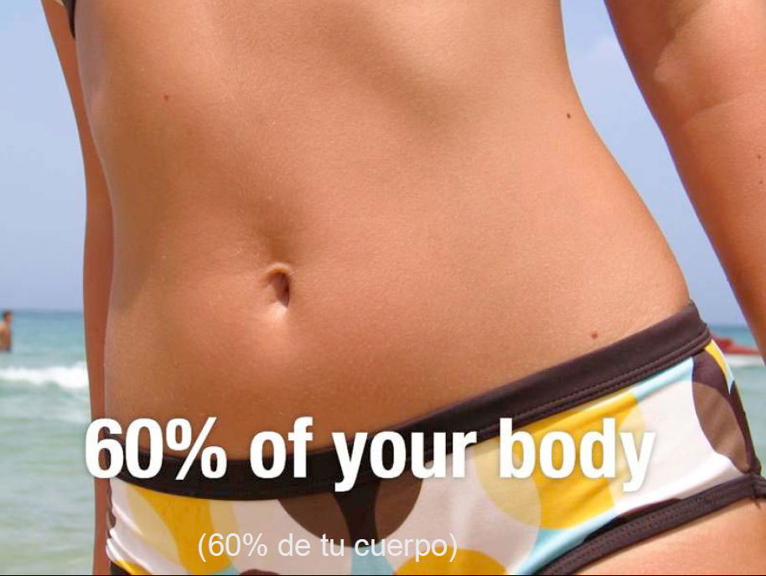
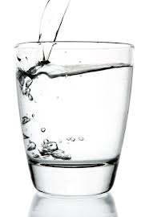
Water is:
?
60% of your body
?

Slide 3
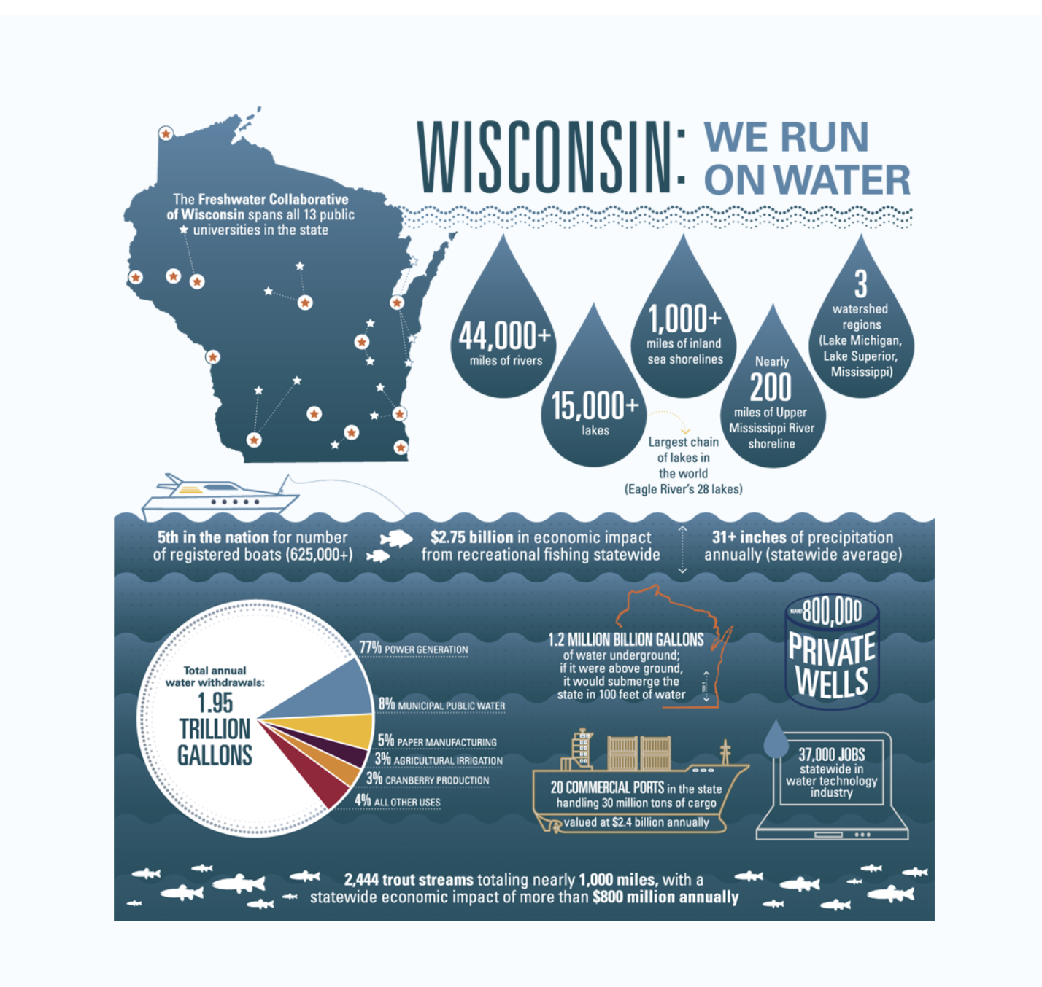
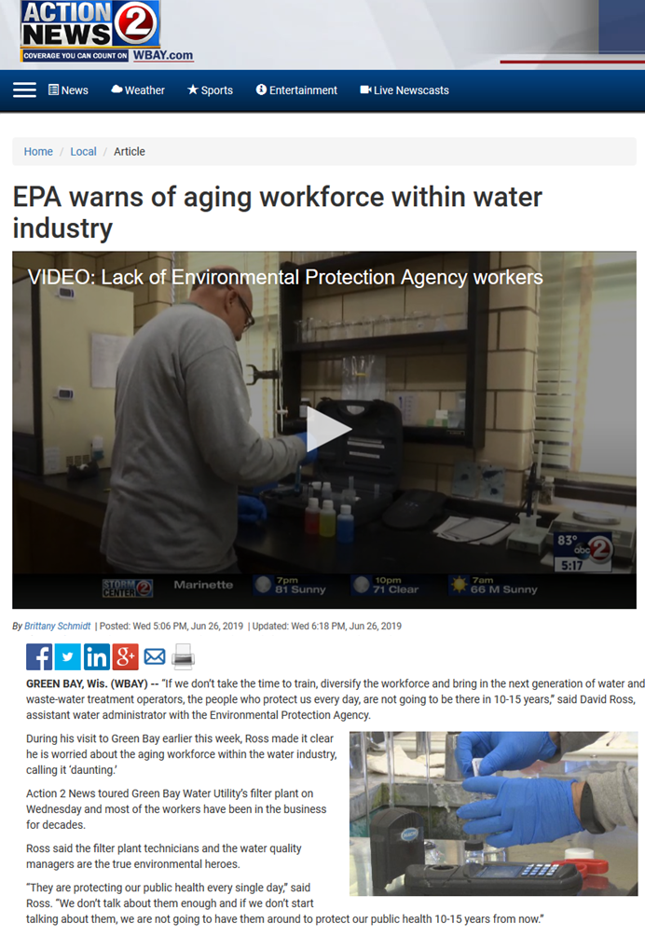
Demand for a workforce
Survey = 68% of WI water sector employers struggle to find well prepared employees
Notes:
UN estimates nearly 2/3 of all industries are water dependent. Water defines WI and its economy. Demographic projections foresee an influx of population as dry regions of the US experience increasing water stress

Slide 4
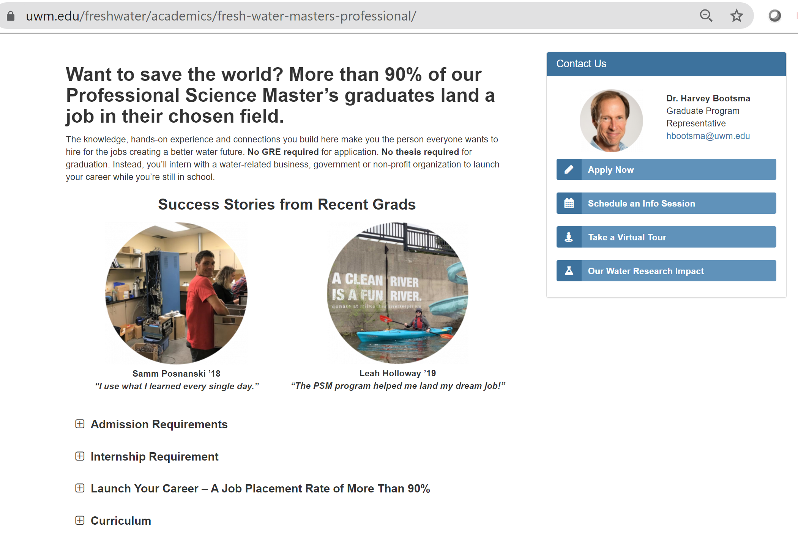
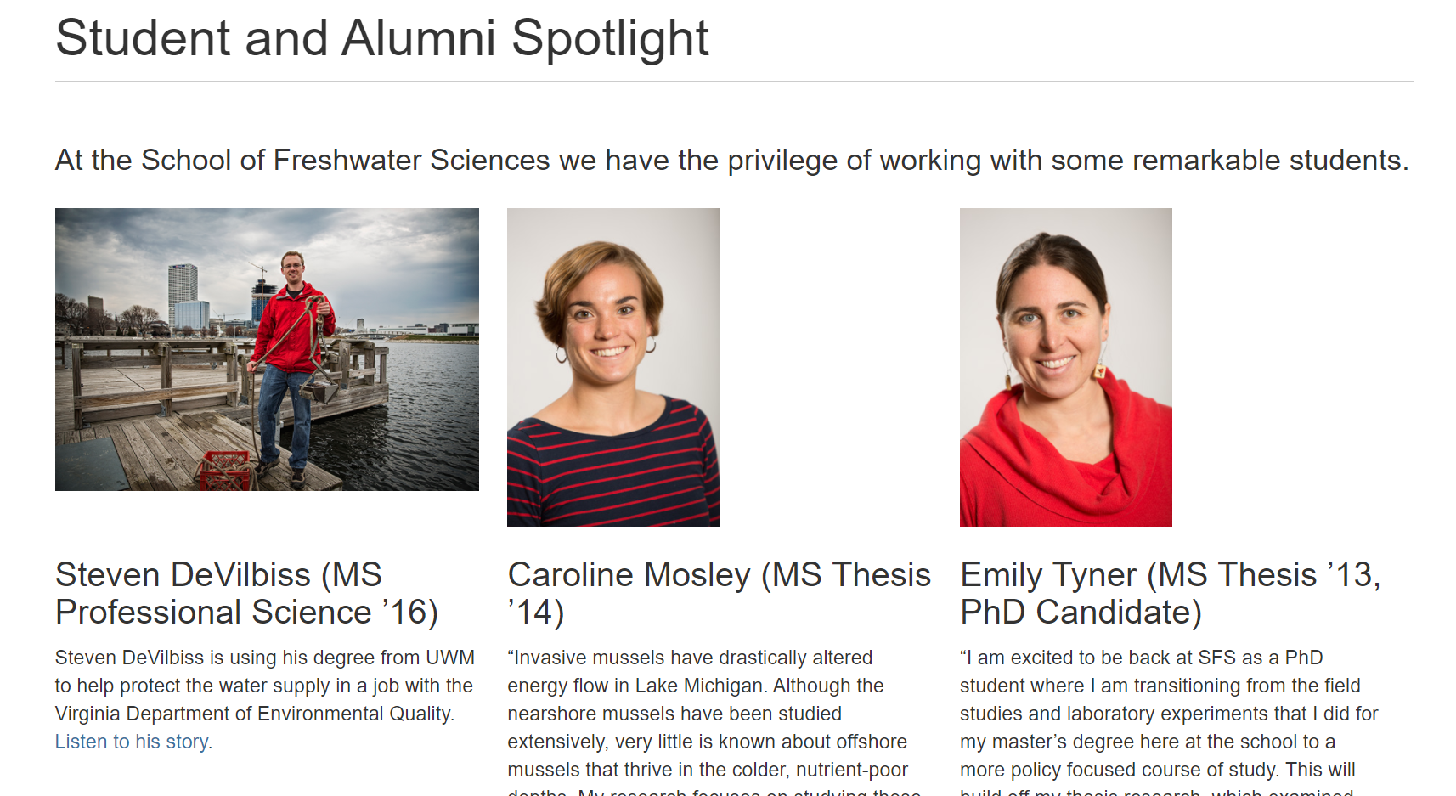
~ 120 graduates to date
20%
Notes:
Our Grad enrollments are up slightly this year. – we believe the result of marketing effort . Caroline works for Wilderness Soc, Steve VA DNR, Emily is the Freshwater Strategy Dir UWGB

Slide 5
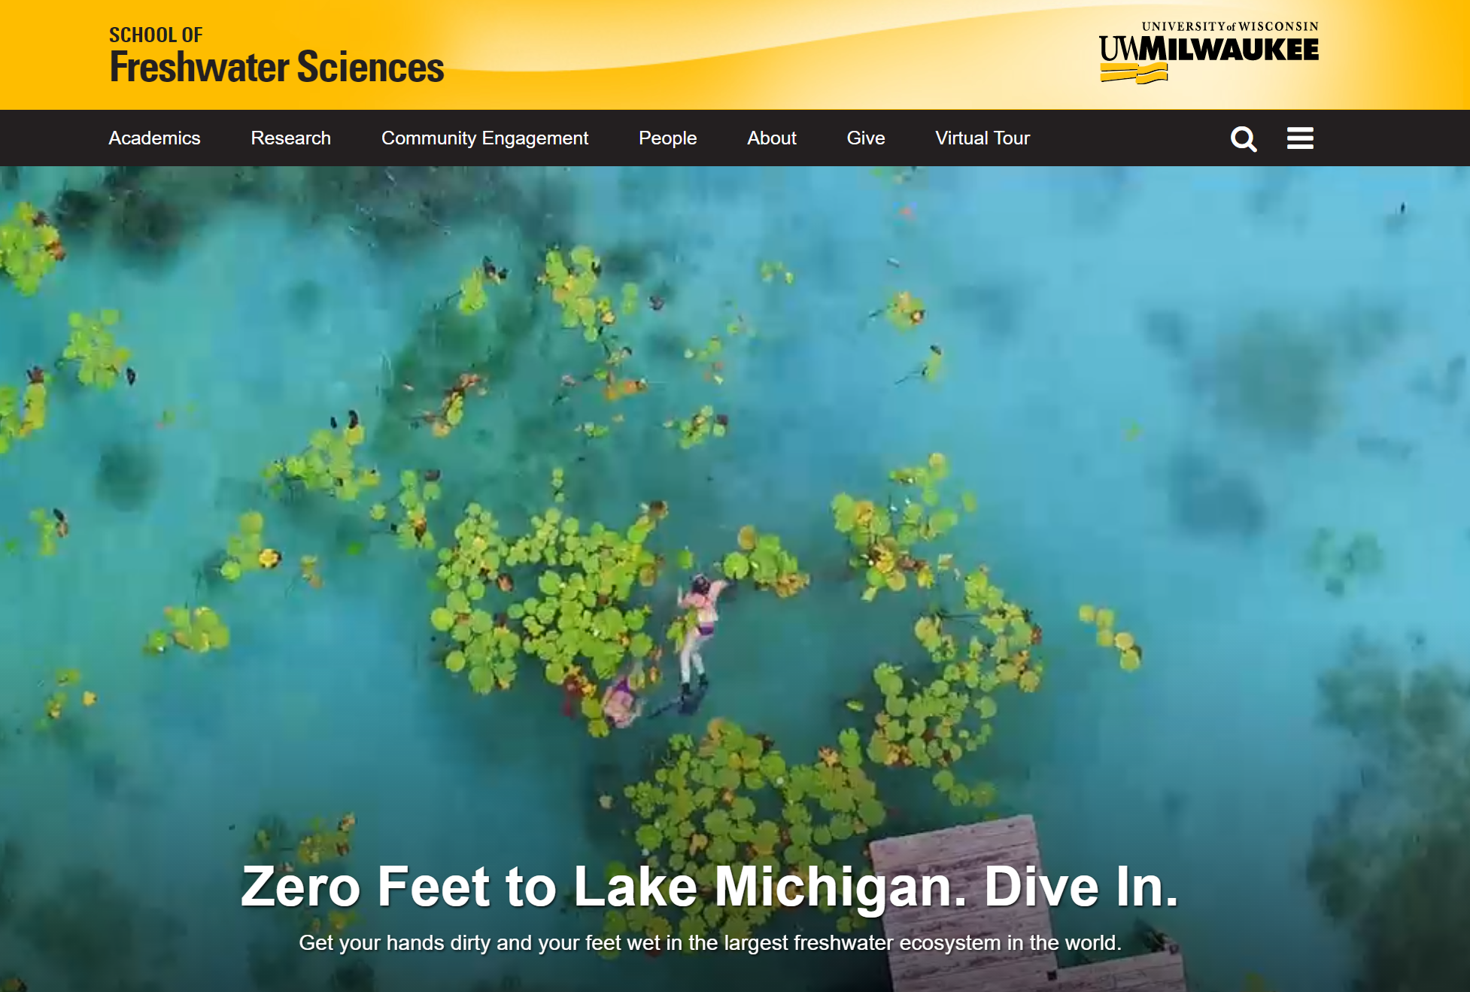
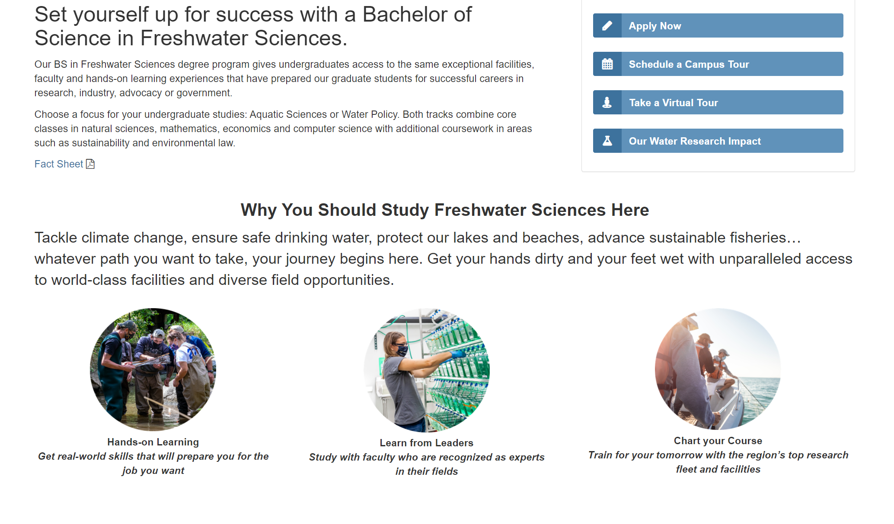
New UG program – Fall 2021
$500 scholarships to new students enrolling full time - supported with donor funds

Slide 6
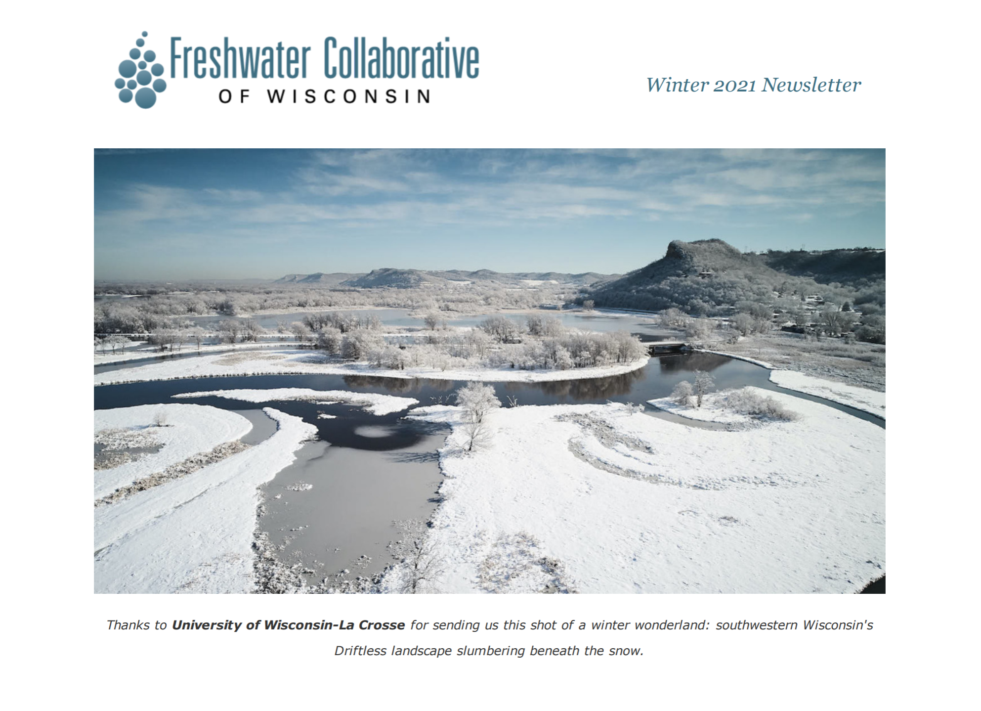
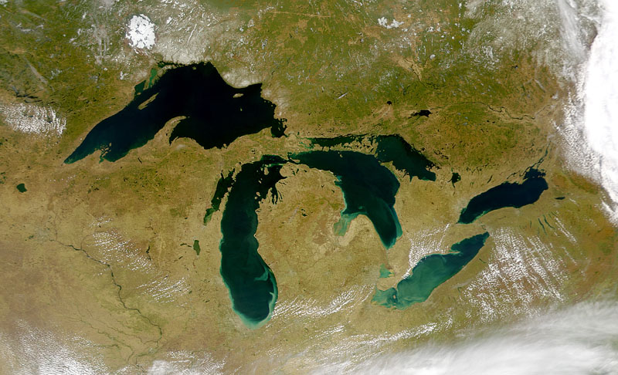
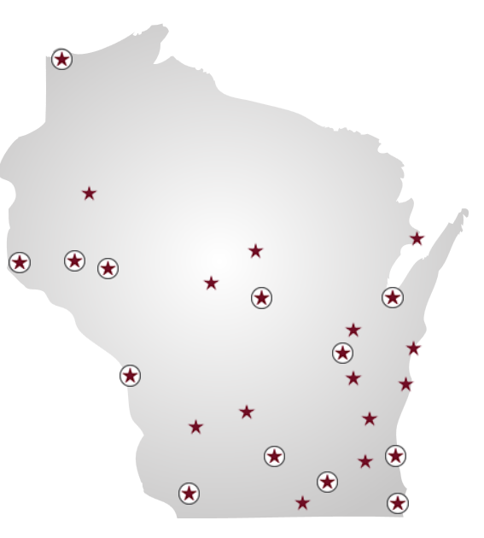






























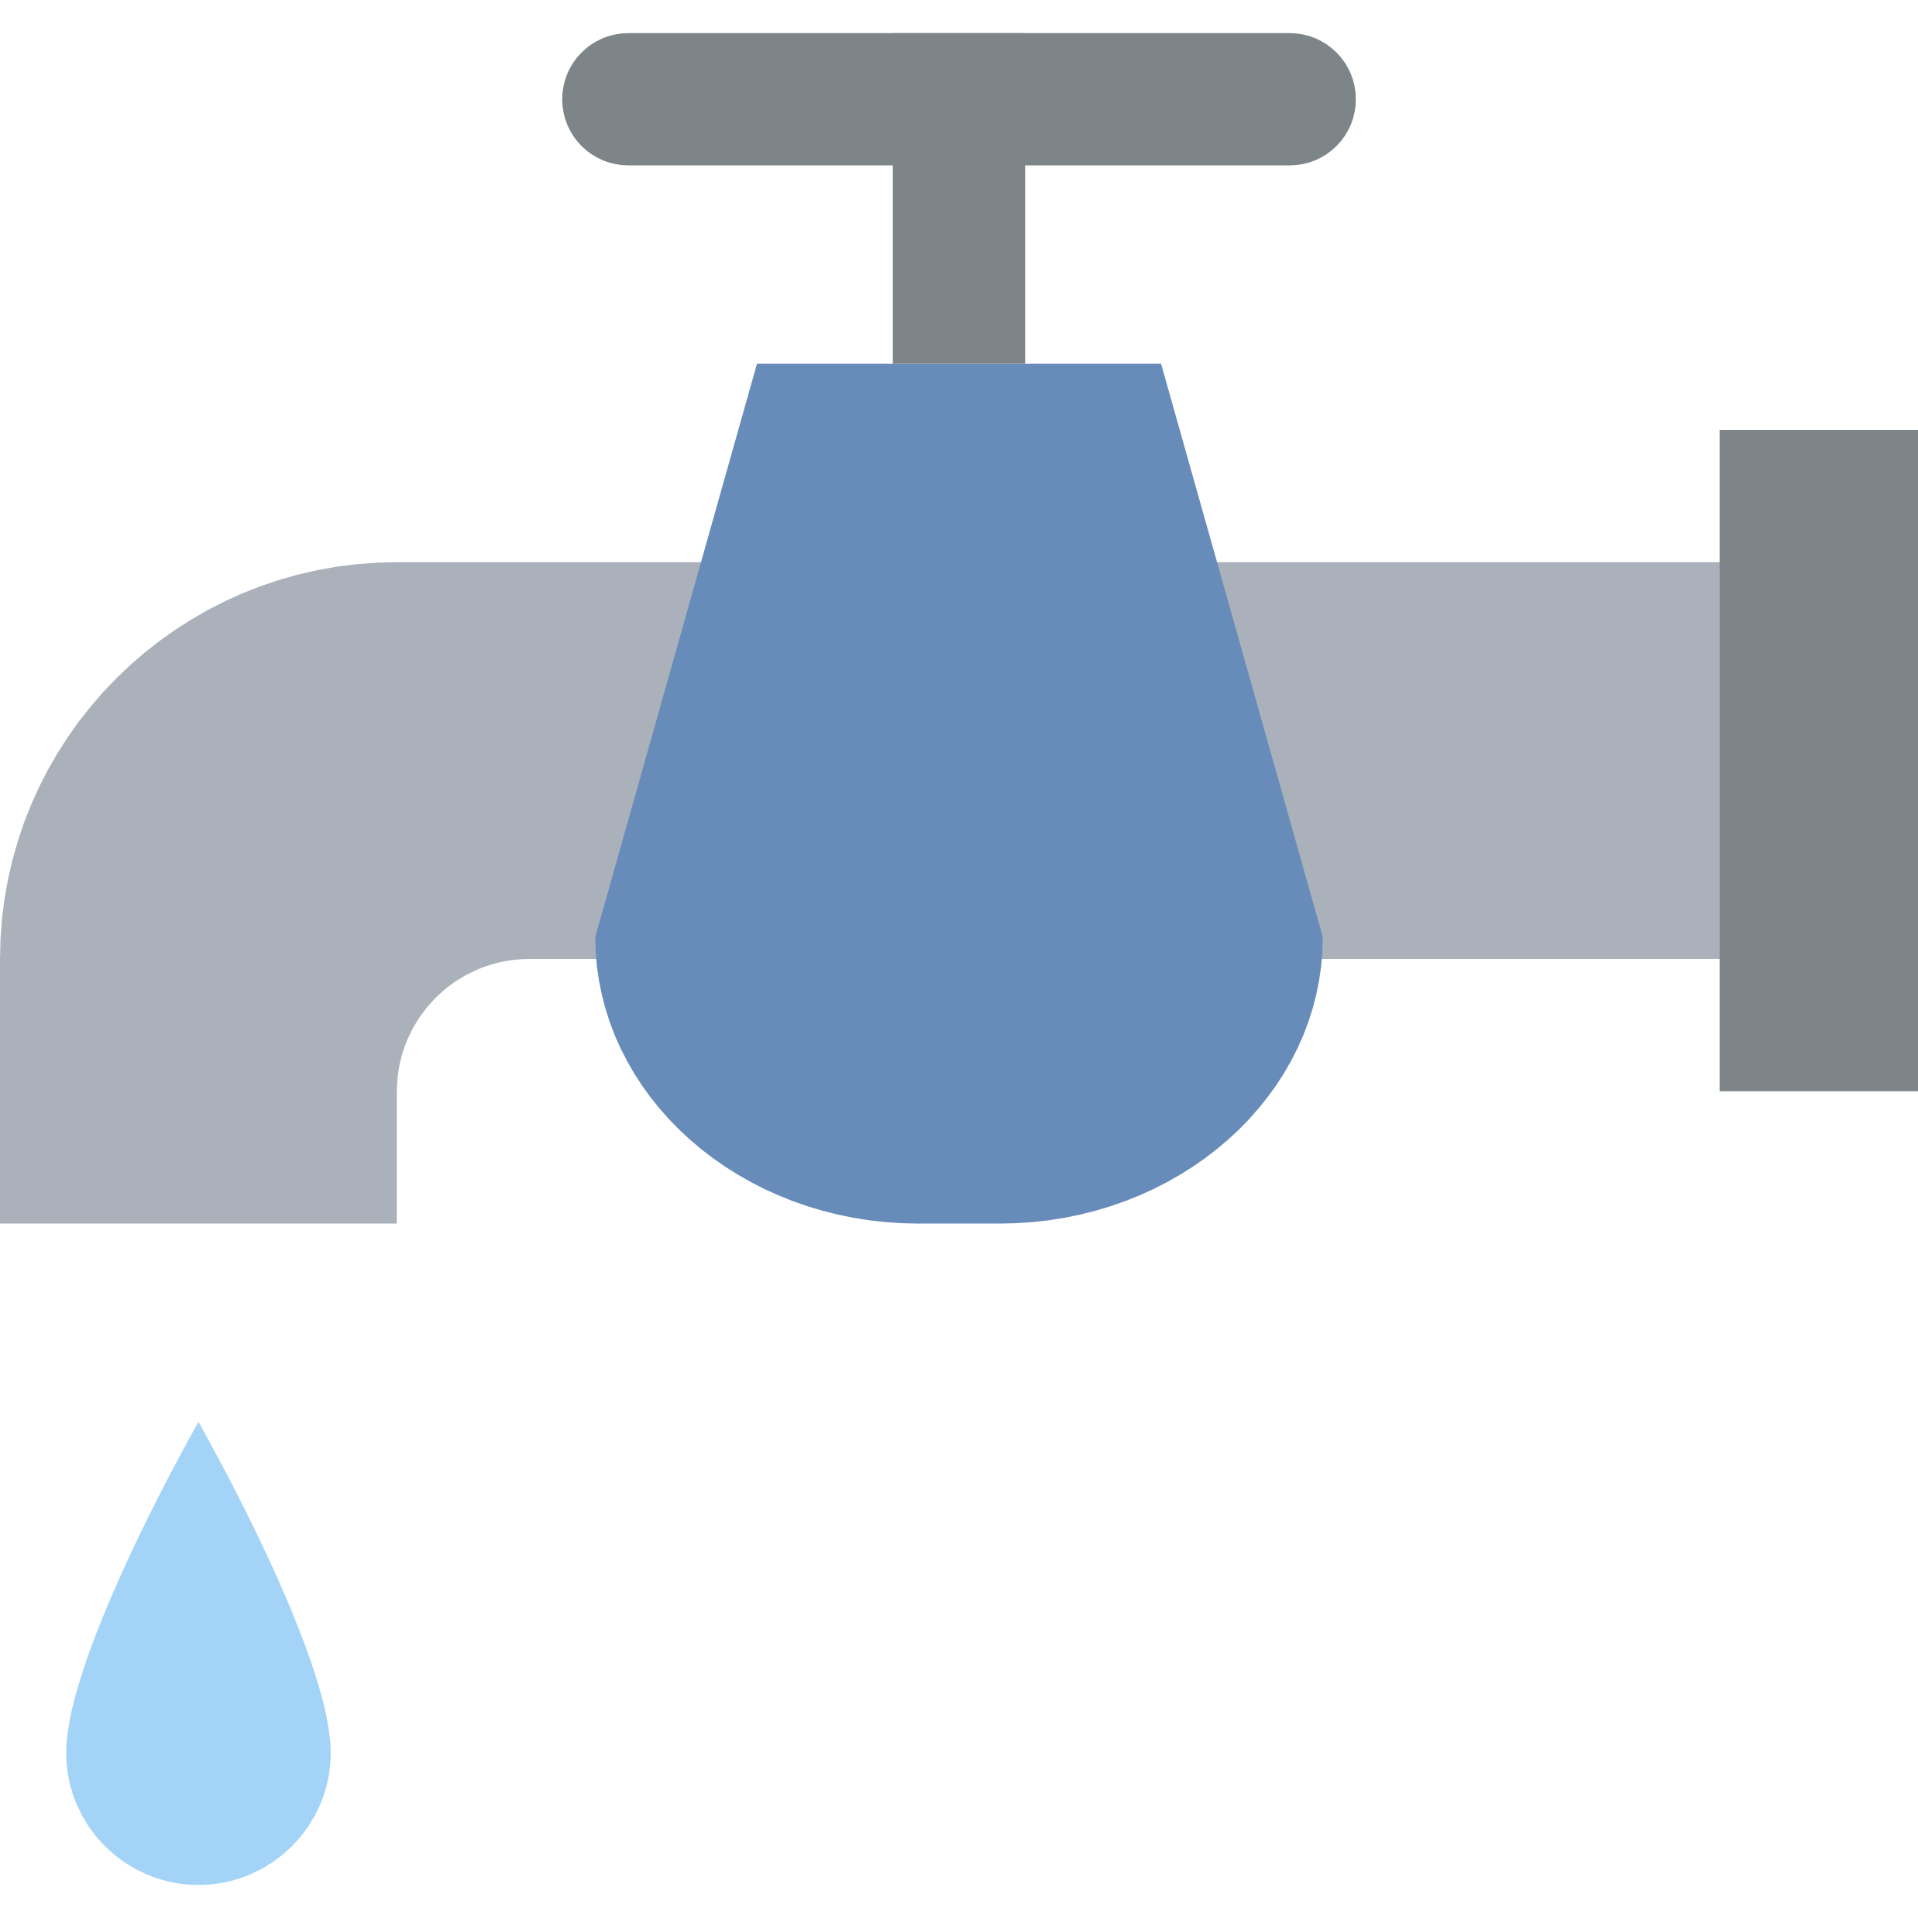




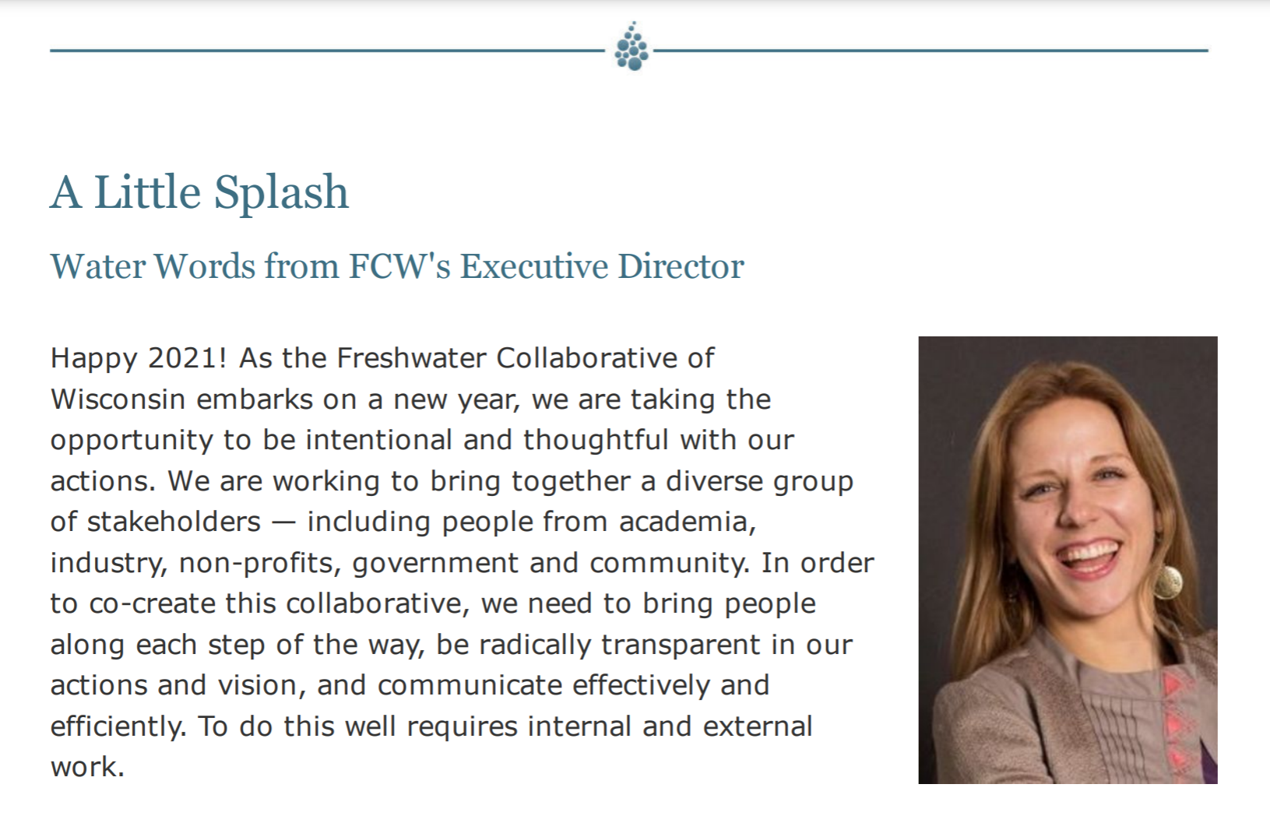












Slide 7
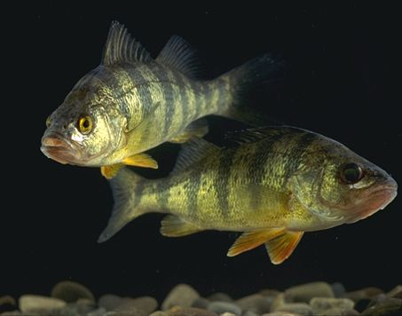
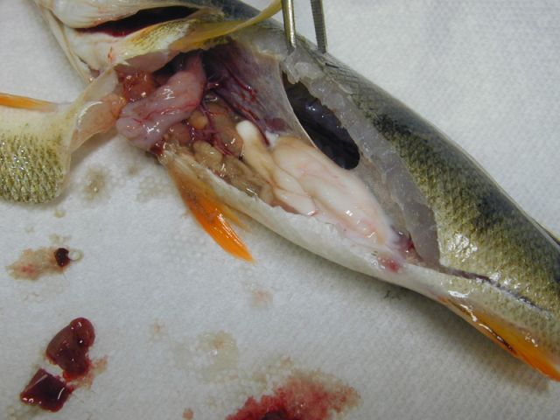
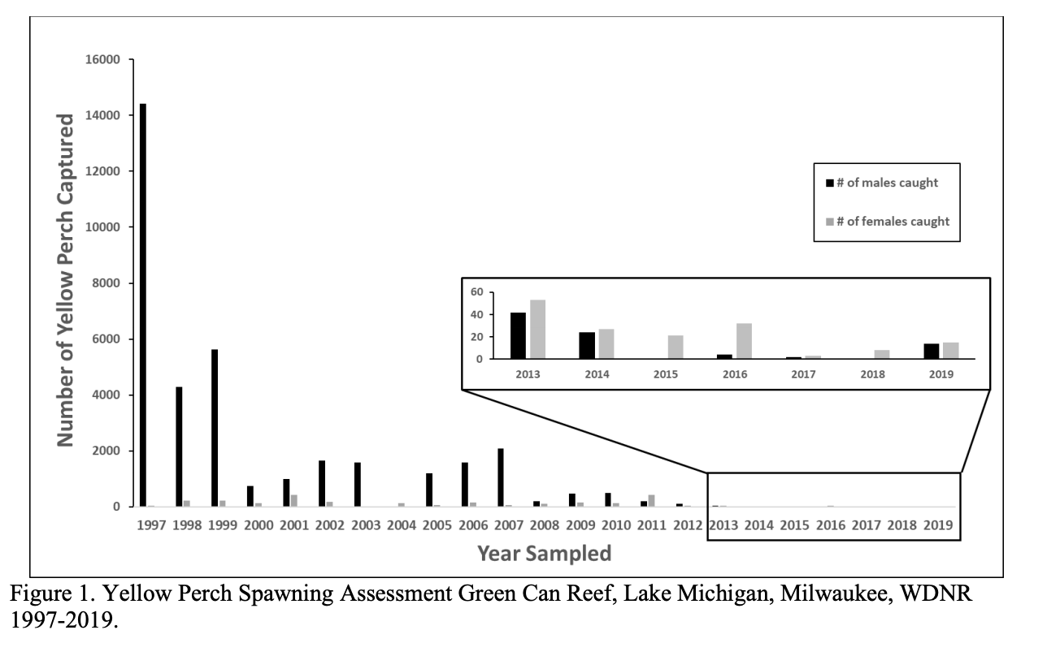
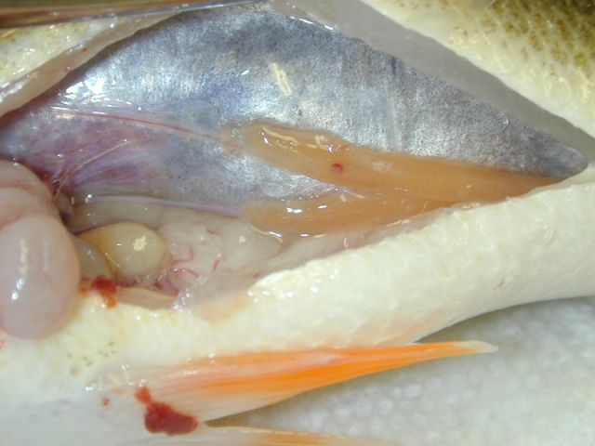
What is causing perch decline?
Klaper lab research: are we measuring impacts of contaminants?
WI DNR 2020 Lakewide Management Report

Slide 8
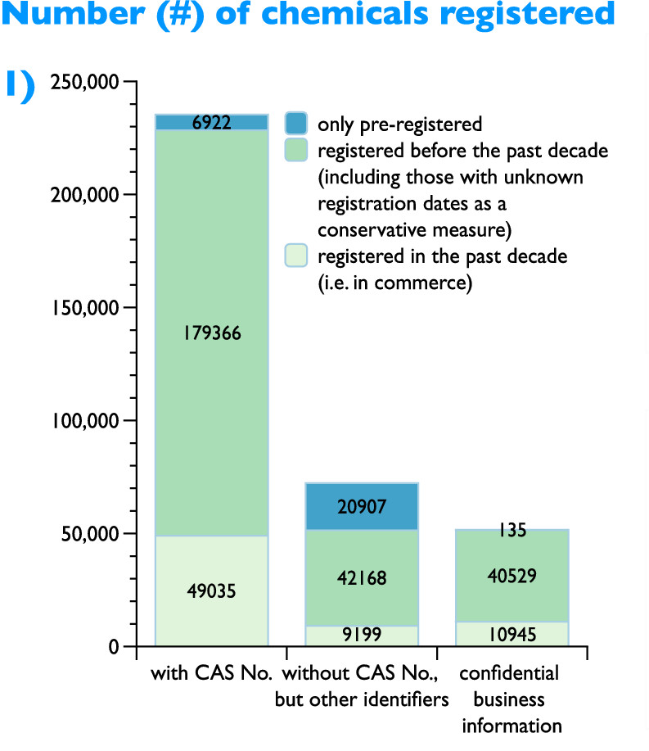
Which chemicals could be causing an impact?
Over 350 000 chemicals and mixtures registered for production and use
3X as previously estimated
Identities publicly unknown
  confidential (over 50 000)
  ambiguous (up to 70 000).
Wang et al. Environ. Sci. Technol. 2020,

Slide 9
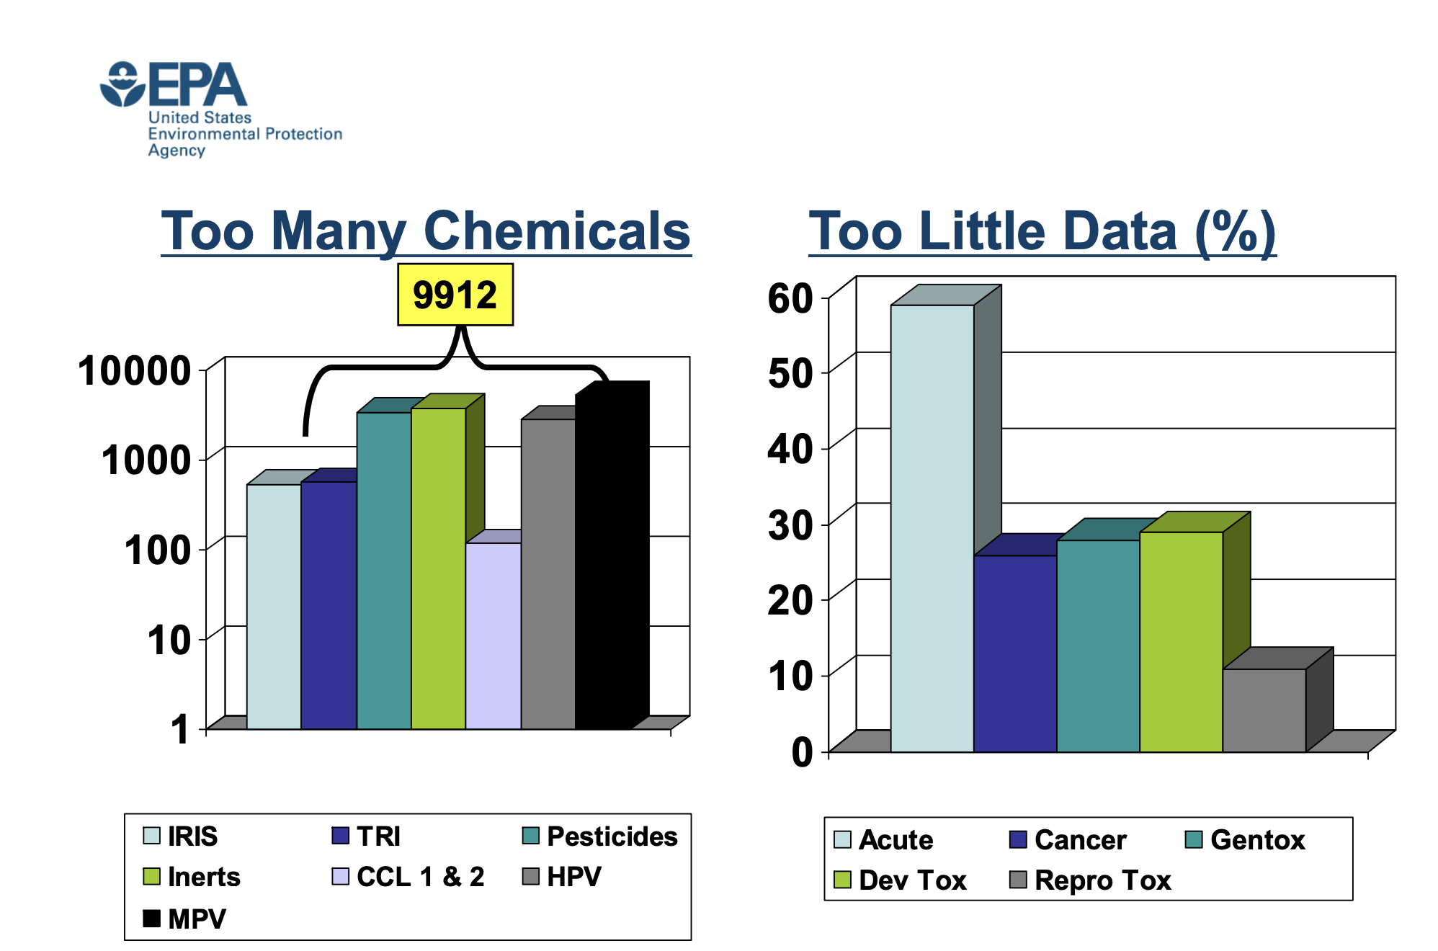
Limited numbers of tests-----Limited data
Other issues?
Limited number of species
Time scale may miss impact
Model organism issues
Not right endpoint
Endpoints not predictive
David Dix US EPA

Slide 10
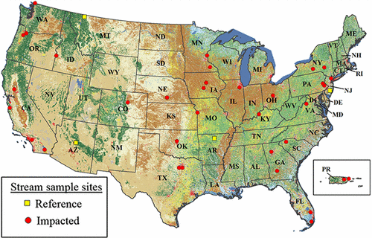
Emerging Contaminants Common in Freshwater Systems
Environ. Sci. Technol. 2017, 51, 9, 4781-4791

Slide 11
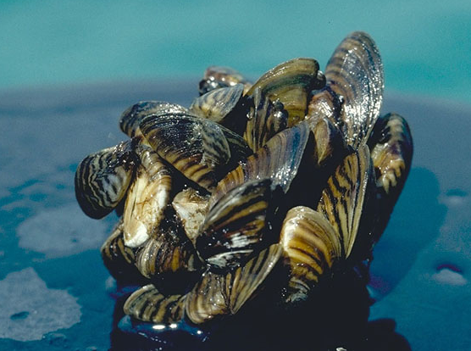
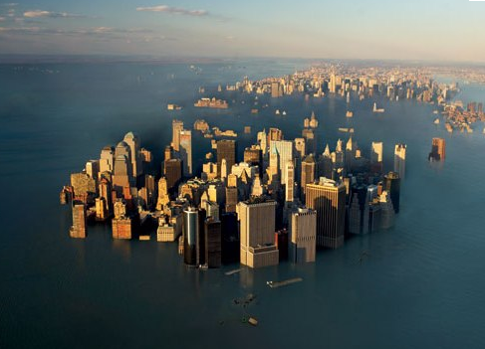
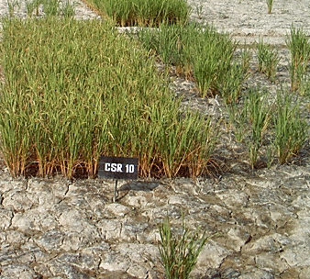

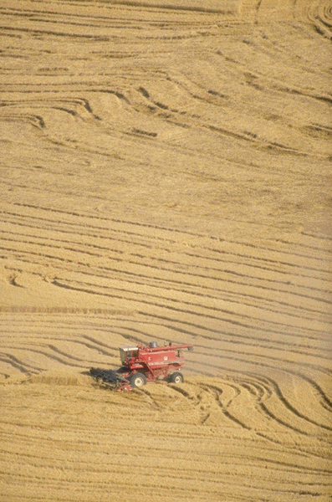
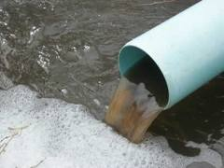
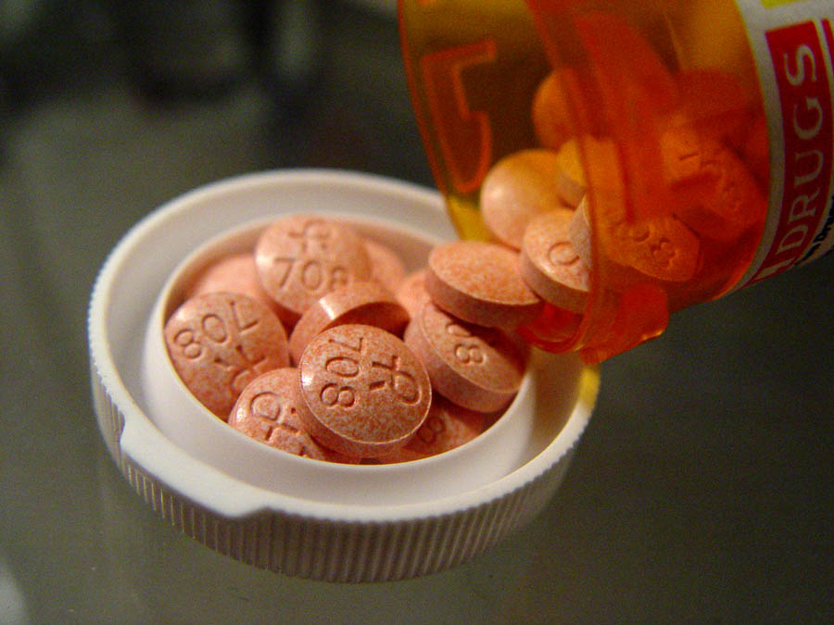
Translation of results to environmental reality: are single chemicals, mixtures, other stressors causing the impact?

Slide 12
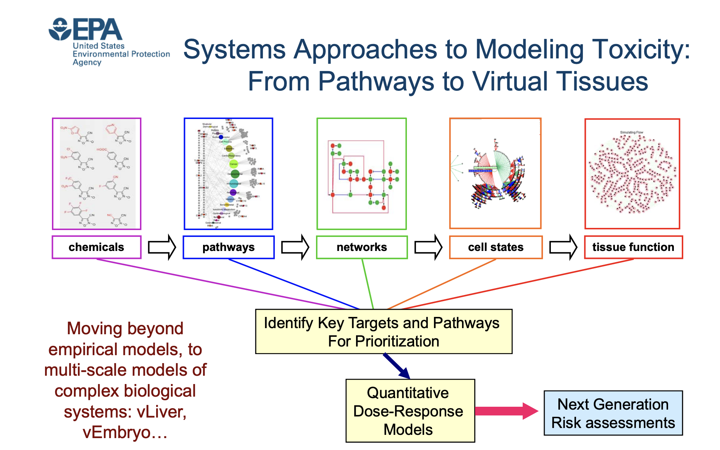
Hope with molecular measurements:
David Dix US EPA
Provide a mechanism to separate impacts
Answer to what is causing the biggest impact
Provide way to predict potential impacts

Slide 13
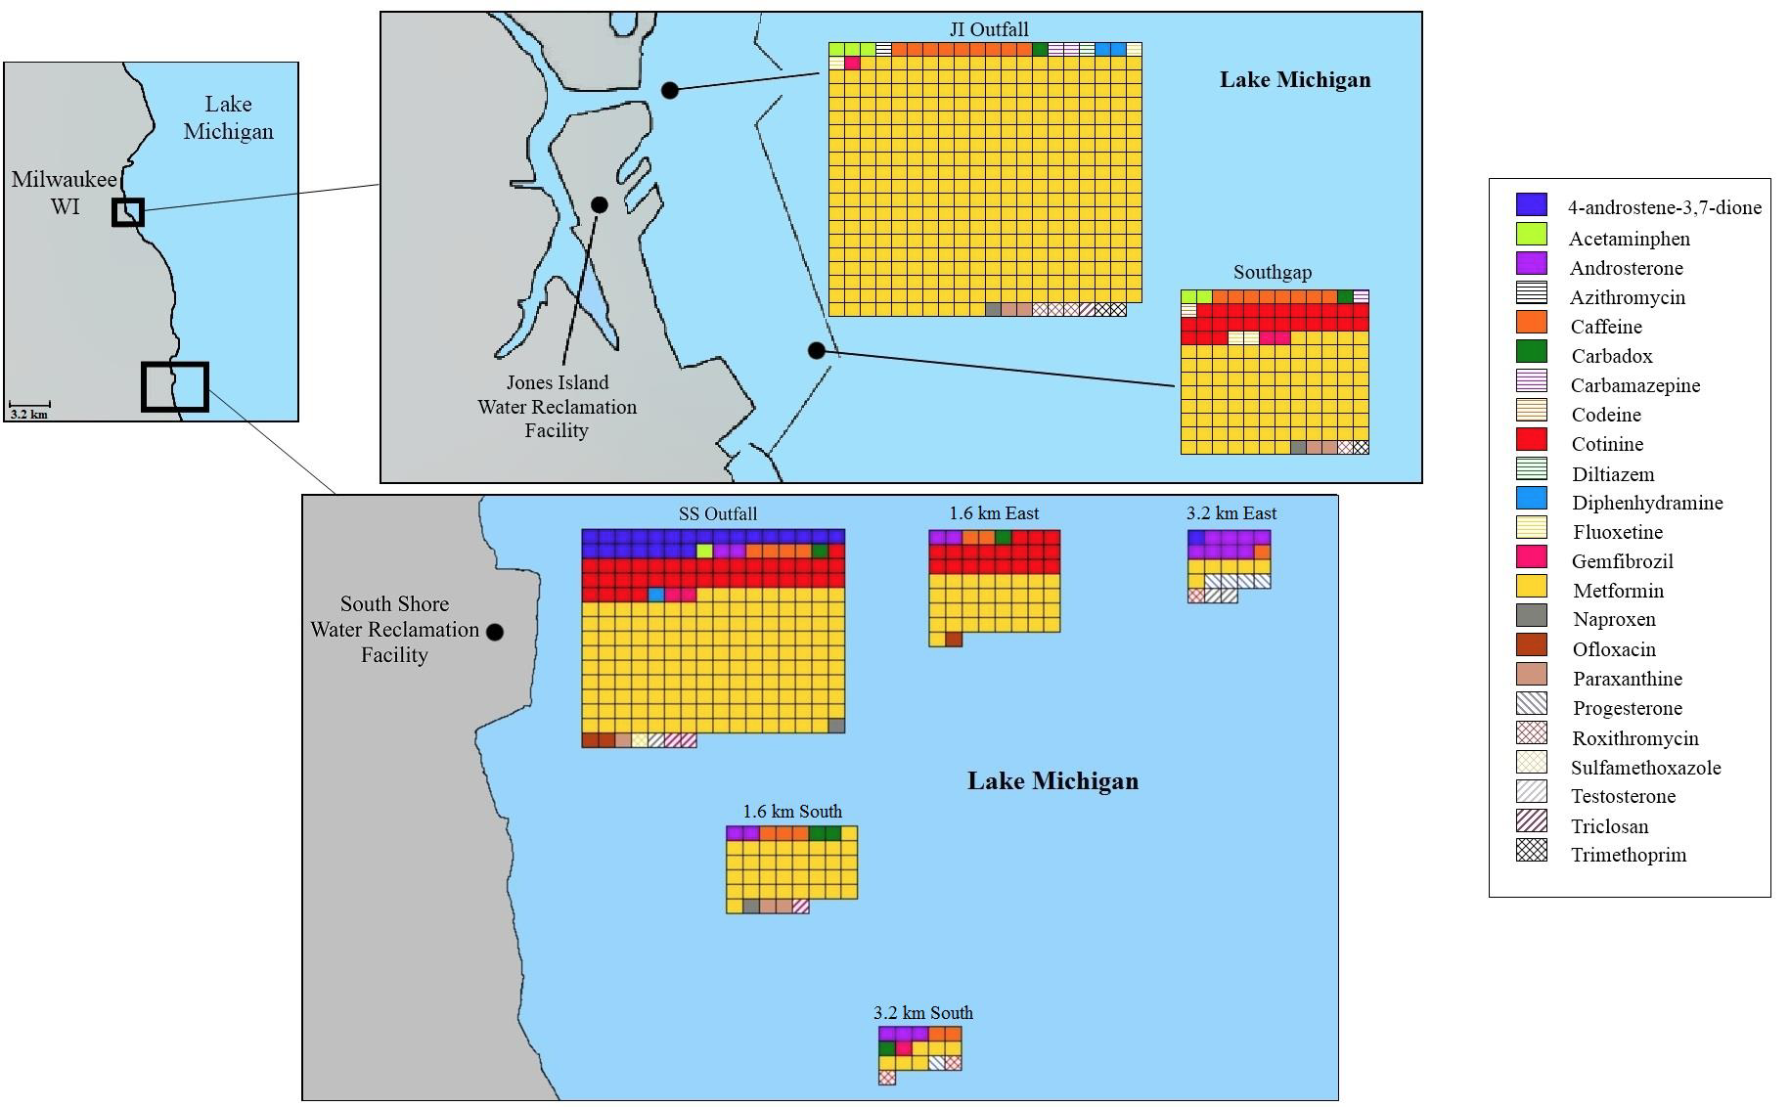
Real world example: Mixtures of pharmaceuticals in the Great Lakes.
Is anything impacting perch?
Blair et al. 2013; 2015

Slide 14
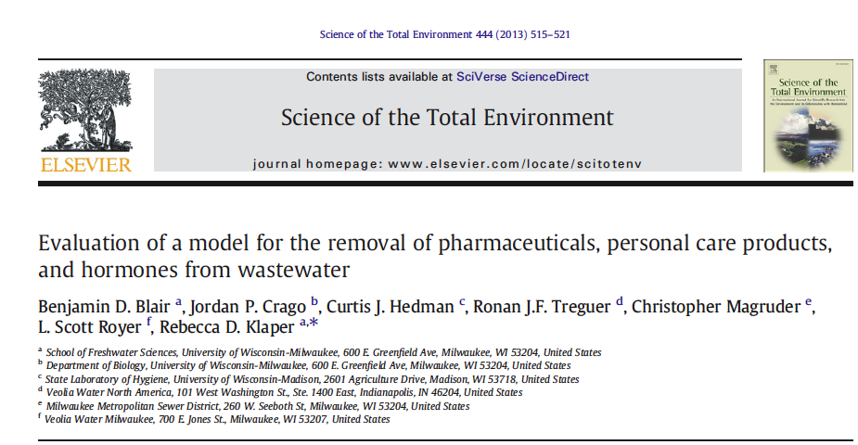
Total average discharge into Lake Michigan
 | Discharge (lbs/year)
Metformin | 14000
Caffeine | 3800
Acetaminophen | 1000
Paraxanthine | 1000
Naproxen | 880
Sulfamethoxazole | 270
Sulfanilamide | 260
Ofloxacin | 220
Trimethoprim | 200
Triclosan | 190
Diltiazem | 170
Ampicillin | 160
Extremely low concentrations
Breakdown
Not therapeutic doses
Don’t reach toxic levels
Does this hold true?
Do they cause any effects?
Only partial information available

Slide 15
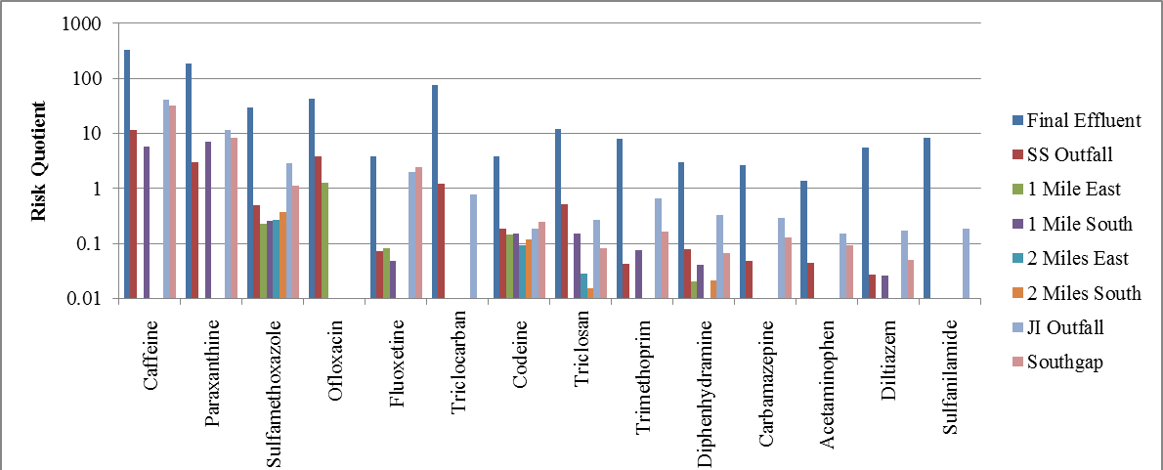
Do they cause any effects?
Only partial information available
Blair et al. 2013

Slide 16
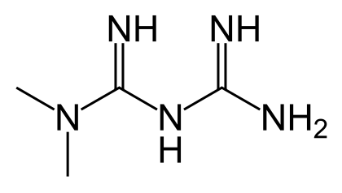
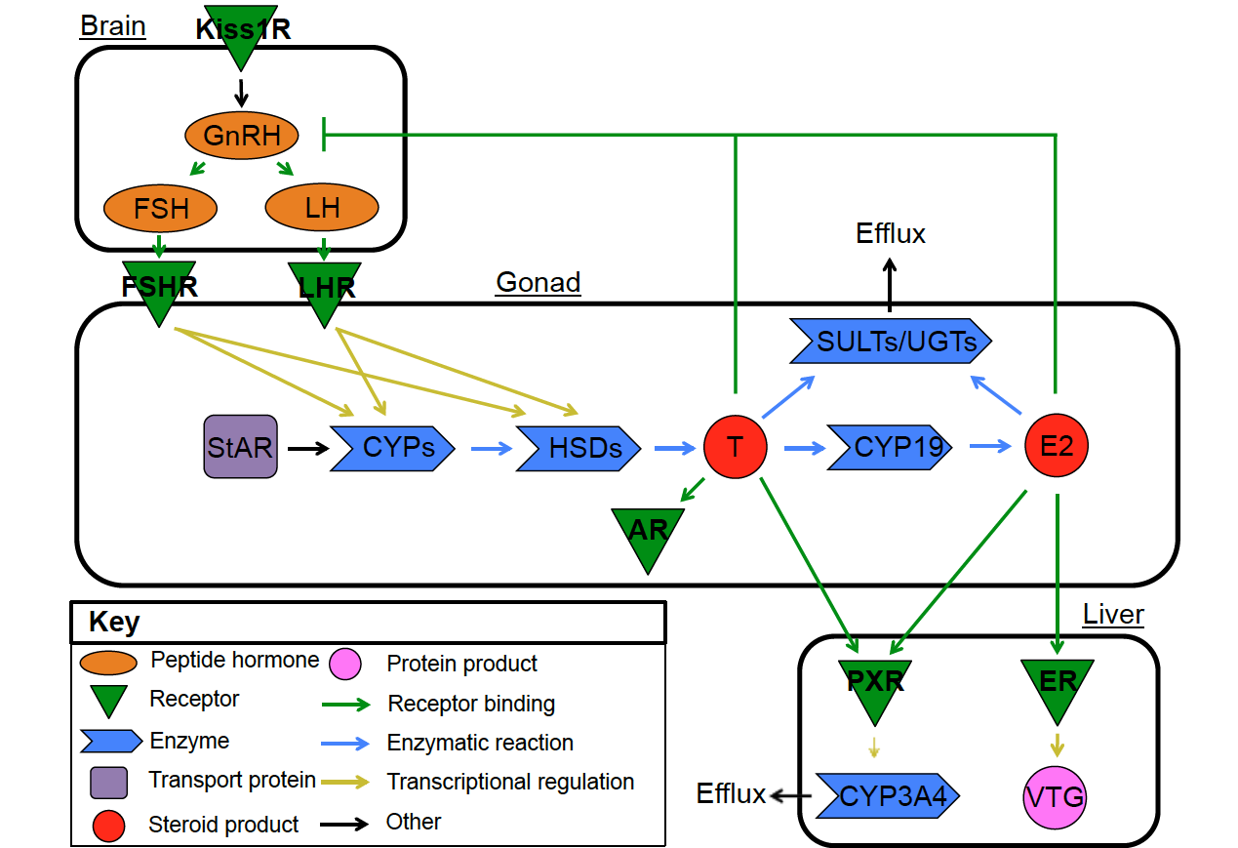
Chemical by chemical: Metformin greatest in concentration and frequency
N,N-Dimethylimidodicarbonimidic diamide
Doesn’t resemble known EDCs
Not predicted to bind to ER (Tox21)
PCOS – lower 17α-OH-progesterone
Pushes endocrine pathways
Niemuth et al. 2014; Niemuth and Klaper 2015
Niemuth and Klaper 2017

Slide 17
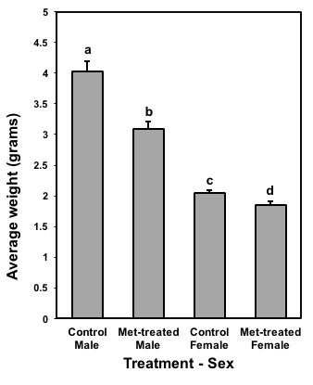
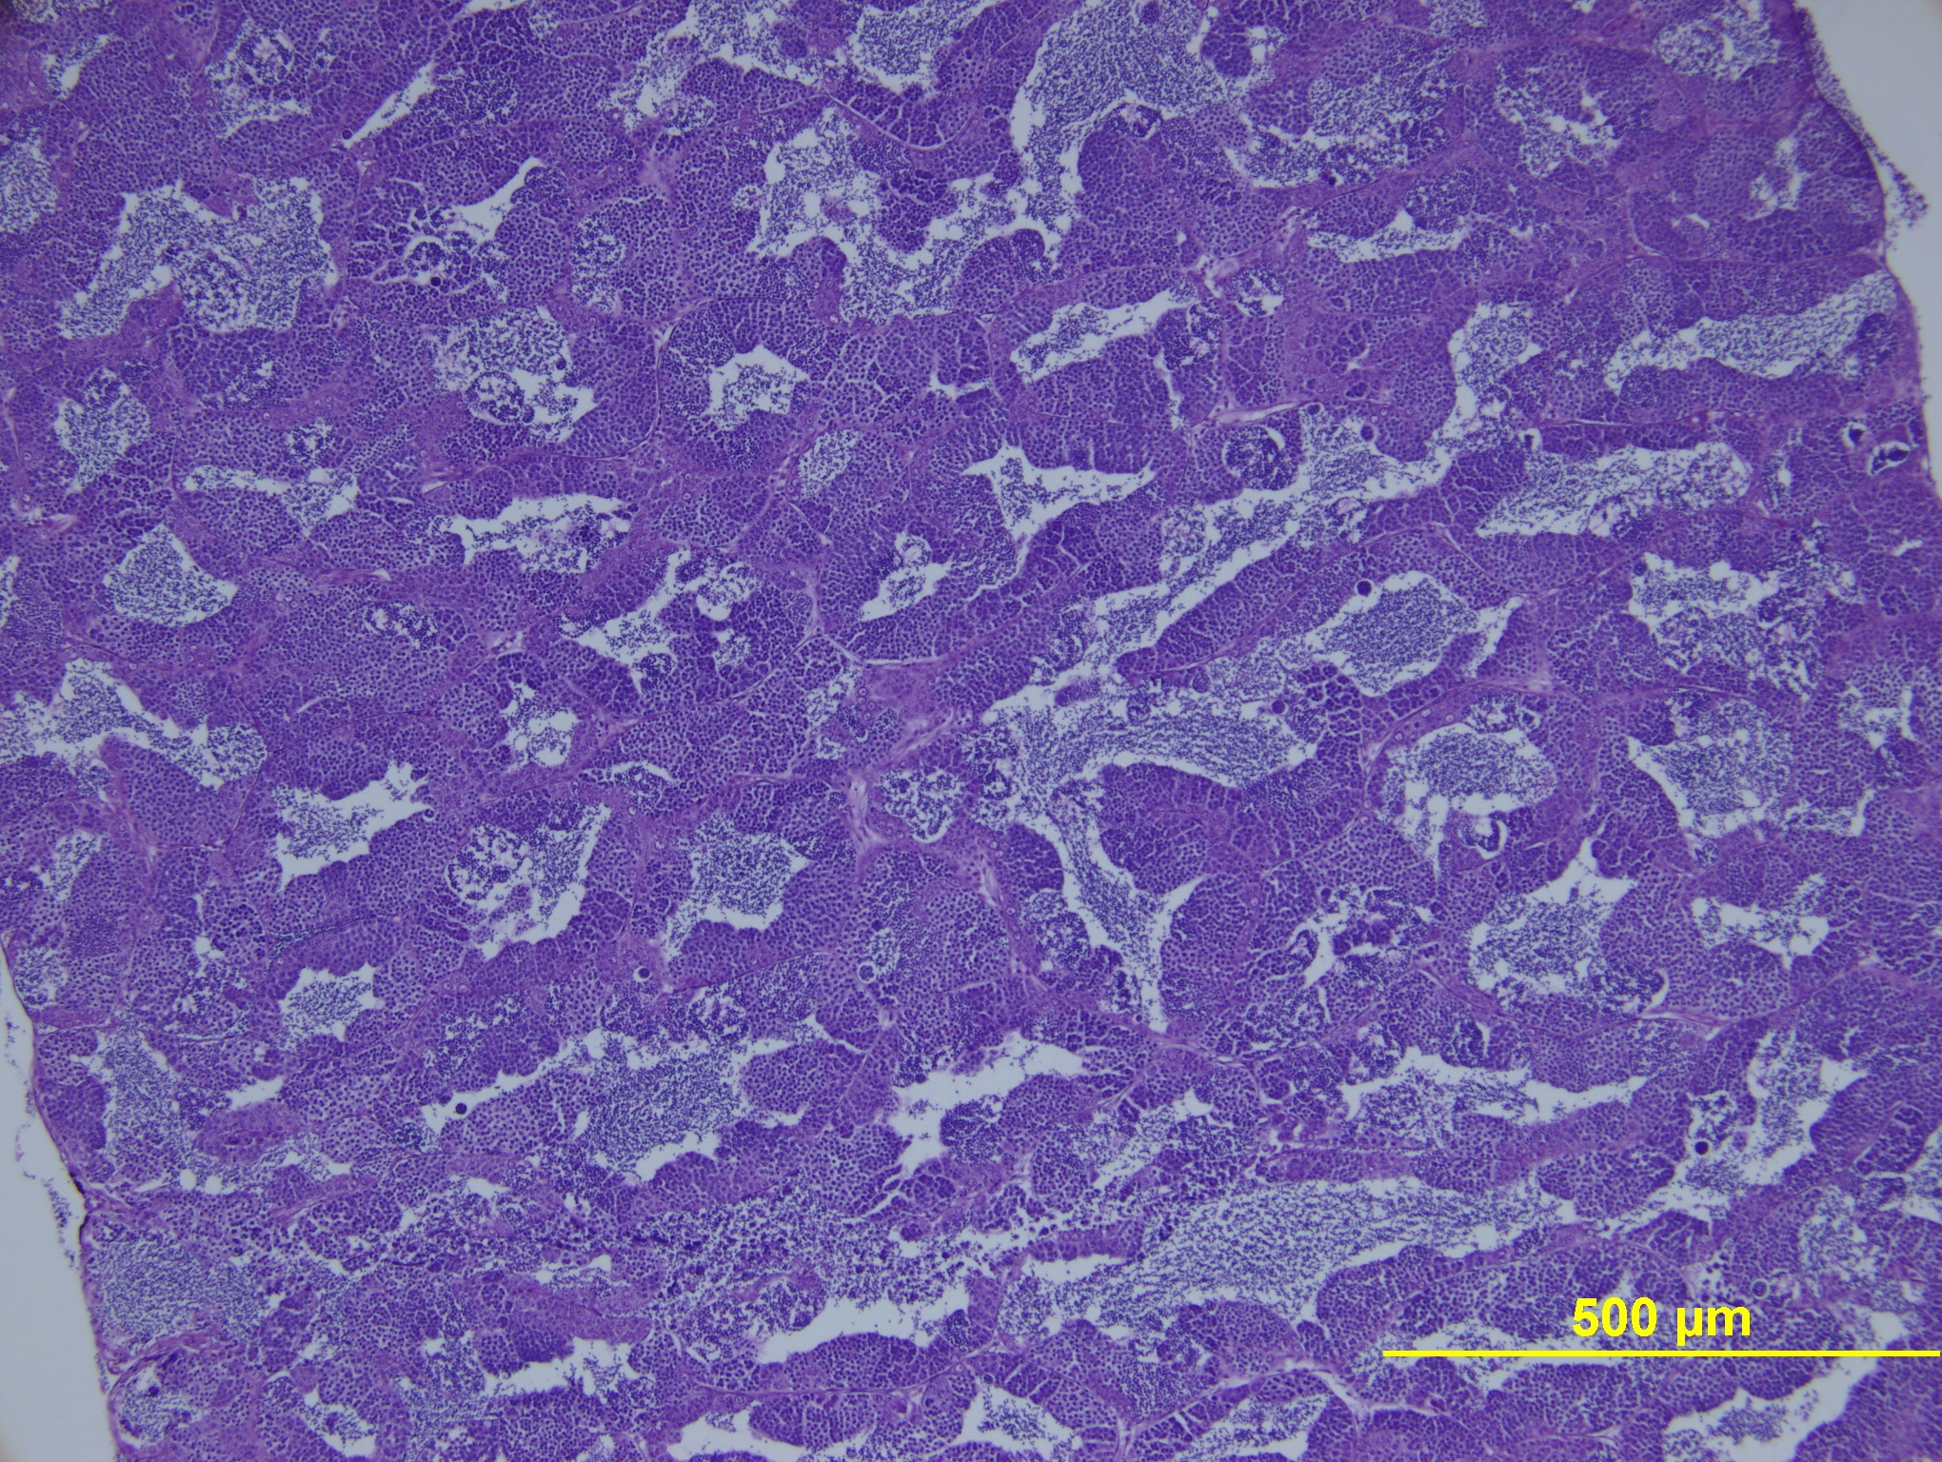
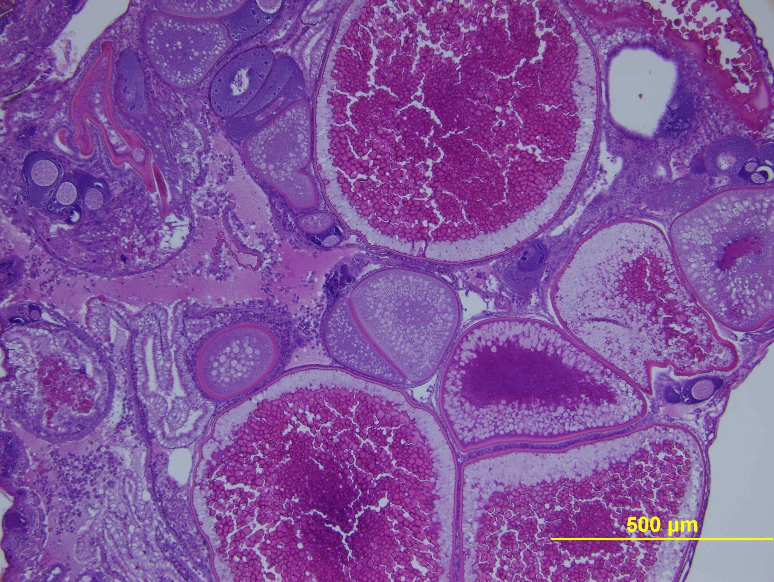
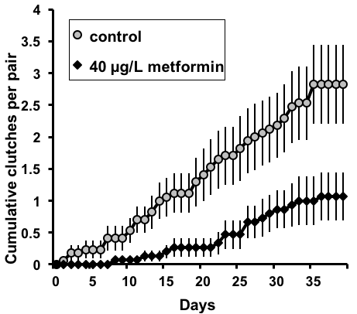
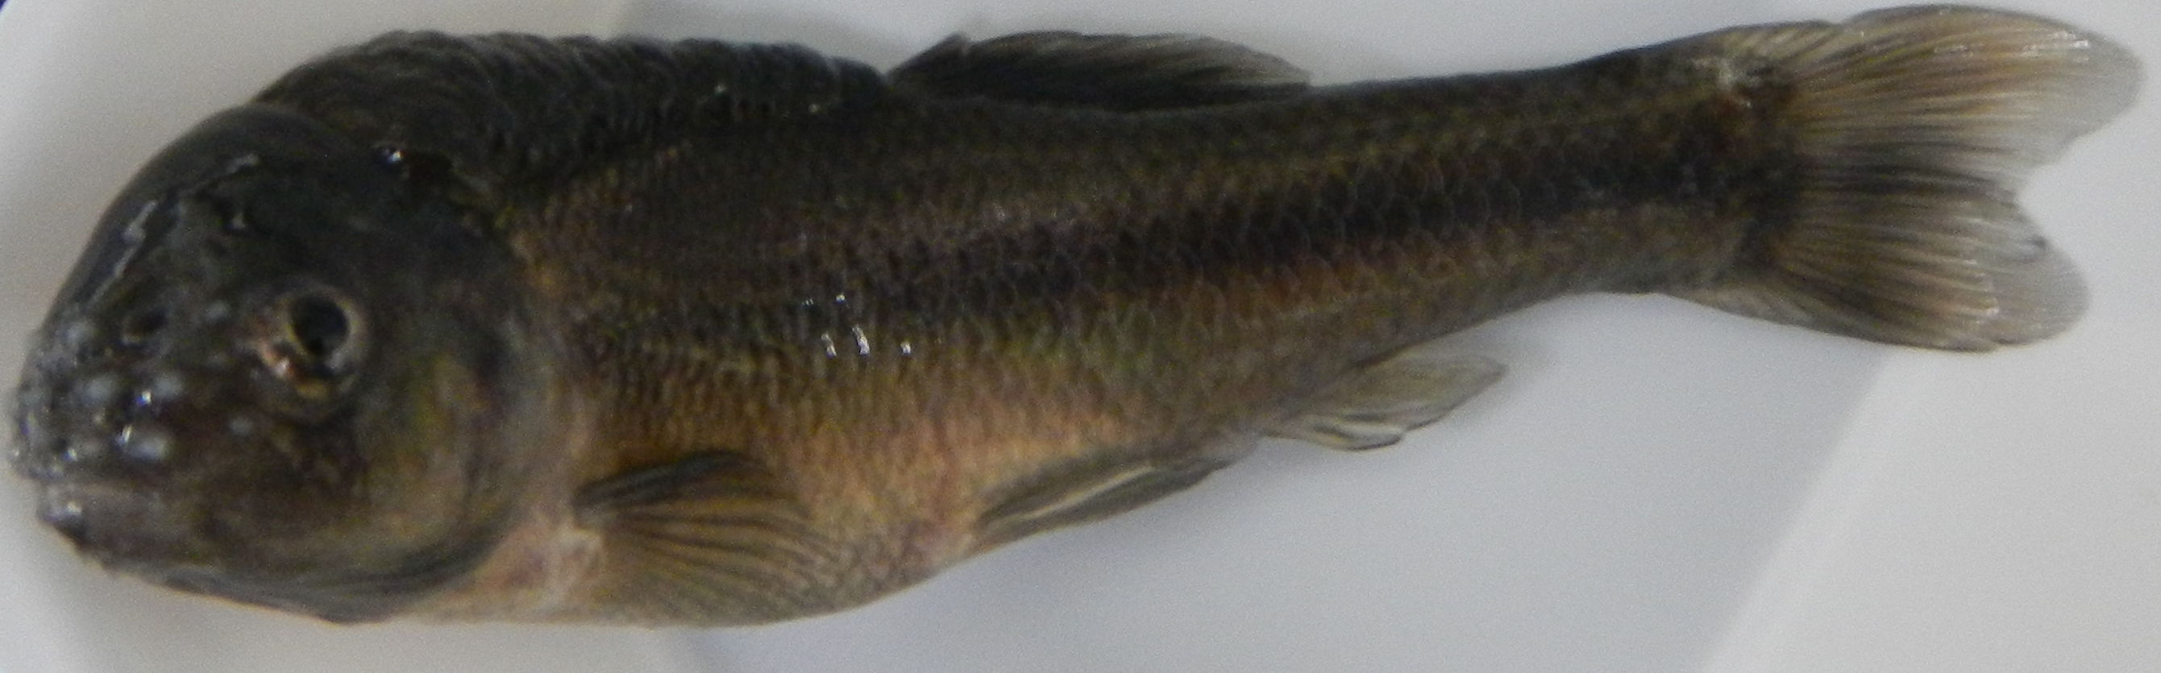
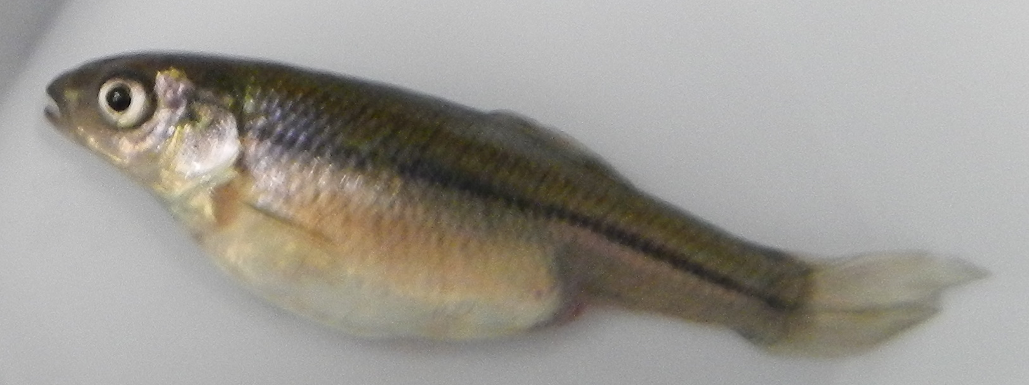
Metformin-treated males show significant intersex gonadal tissue
0
7
Niemuth and Klaper 2015
Notes:
Figure 1. Intersex scoring for histological sections of gonad from control males and FHM males exposed to 40 μg/L metformin for 360 days. Intersexuality was scored on a 0-7 scale. a) Error bars represent ±SEM. N=: control males, 17; treated males, 16. Metformin-treated males were found to have a significantly higher intersexuality score; independent samples T-test, p<0.001. Representative histology slides are shown as follows: b) normal male testis, as seen in a control male FHM; c) intersex score of 2, infrequent perinucleolar follicles (PNF) scattered throughout otherwise normal testis, here in an exposed male fish; d) score of 3, frequent PNF scattered throughout testis, seen in an exposed male; e) score of 4, frequent PNF and possibly cortical alveolar oocytes (CAO) clumping throughout testis; f) score of 5, less than 50% of testis is composed of PNF, CAO, and possibly also early or late vitellogenic oocytes (EVO,LVO); g) score of 6, >50% of testis composed of PNF, CAO, EVO, LVO, and possibly mature oocytes (MSO); h) stage 7, 100% conversion of gonad to oocytes of varying stages.

Slide 18
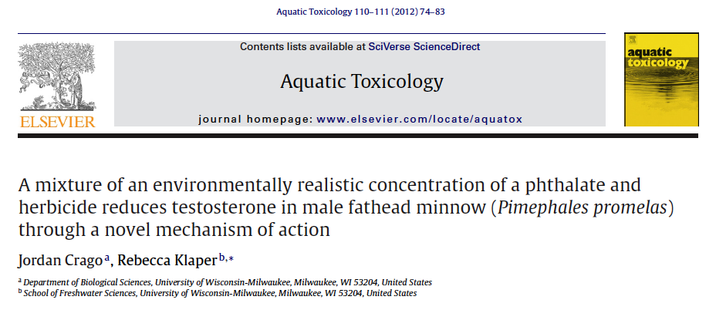
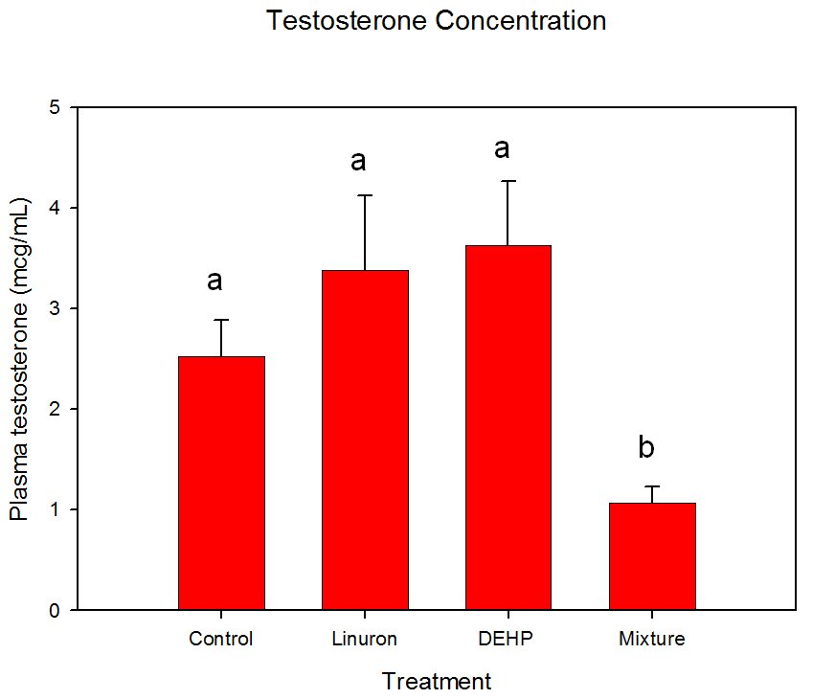
Need more information on mixtures:
Mixture Linuron and DEHP Impacts Testosterone
Synergistic effect
ANOVA p = 0.021, F = 3.847, df = 30.

Slide 19
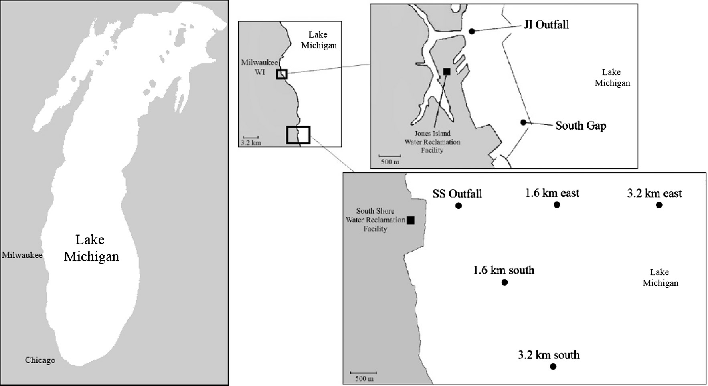
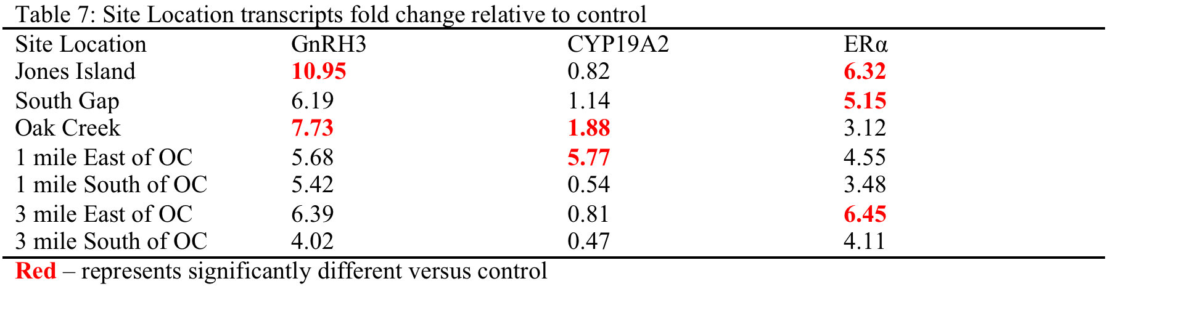
What about mixtures: some locations collective impact where individual chemicals not significant
Are there better ways to measure impacts of large numbers of chemicals in dynamic mixtures?
Crago and Klaper 2017
E2 1 ppt = 5 fold change versus control
Notes:
Results from this study indicate that 5 of the 7 different chemical mixtures representing concentrations of the 5 individual chemicals measured at seven different locations in Lake Michigan significantly altered the relative expression of at least one of the three transcripts.

Slide 20
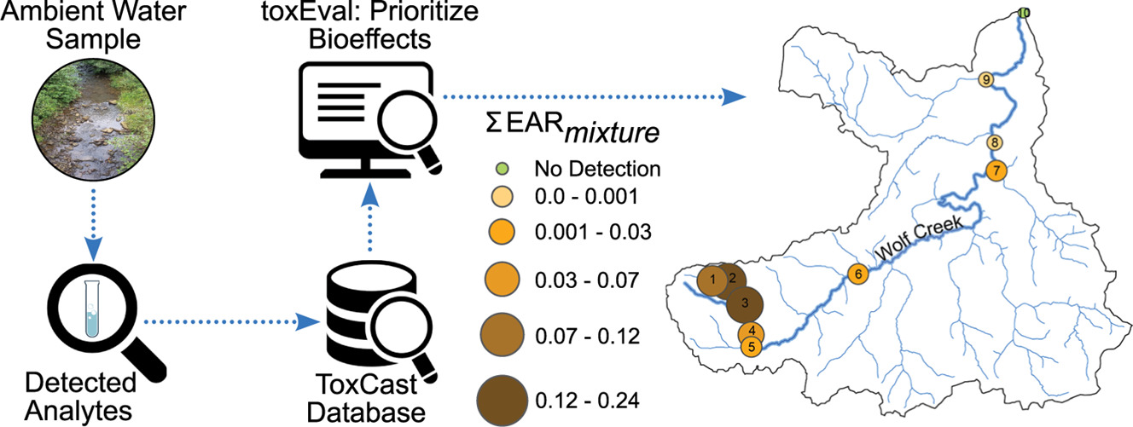
How do we evaluate large numbers of chemicals? Combine HTS data with chemical analysis
Rose, L.D., Akob, D.M., Tuberty, S.R., Corsi, S.R., DeCicco, L.A., Colby, J.D. and Martin, D.J., 2019. Use of high-throughput screening results to prioritize chemicals for potential adverse biological effects within a West Virginia watershed. Science of the Total Environment, 677, pp.362-372.

Slide 21
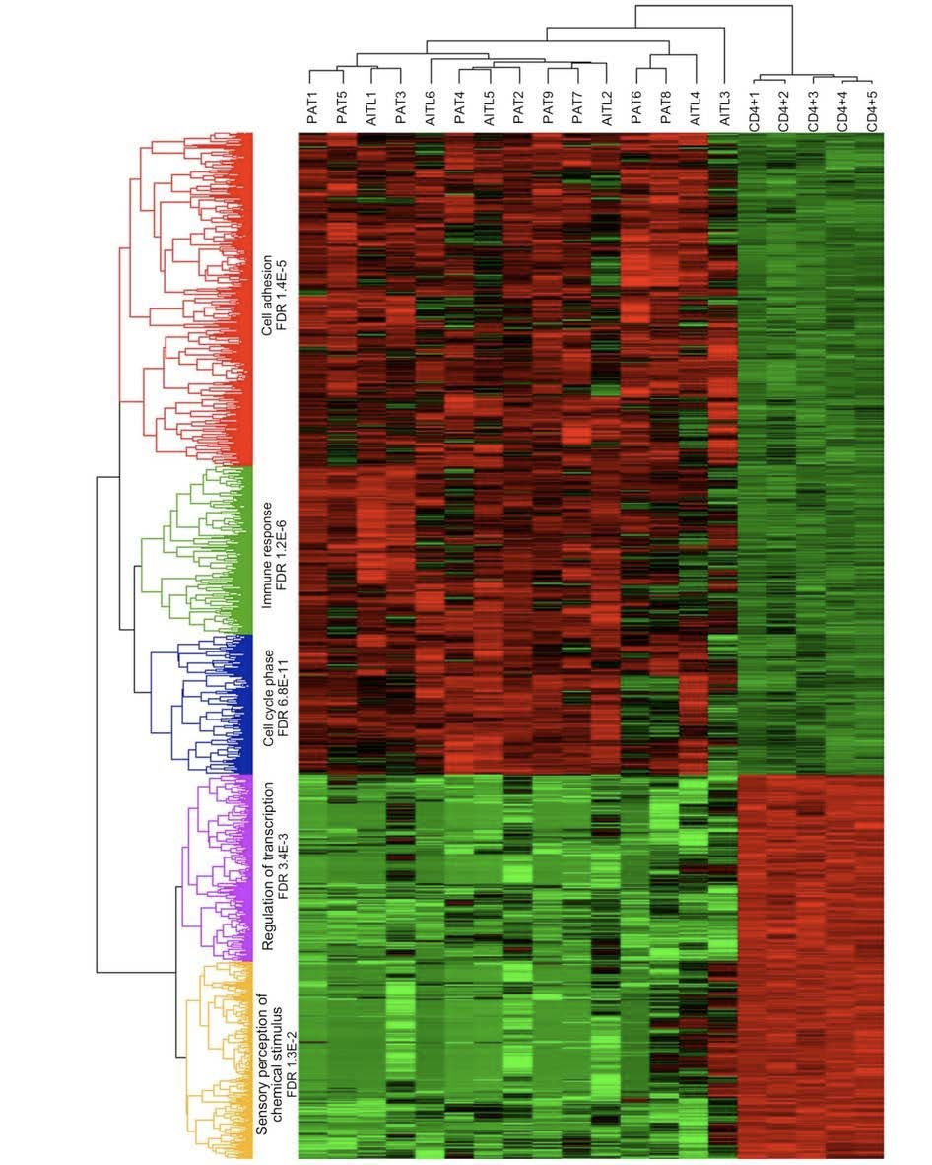
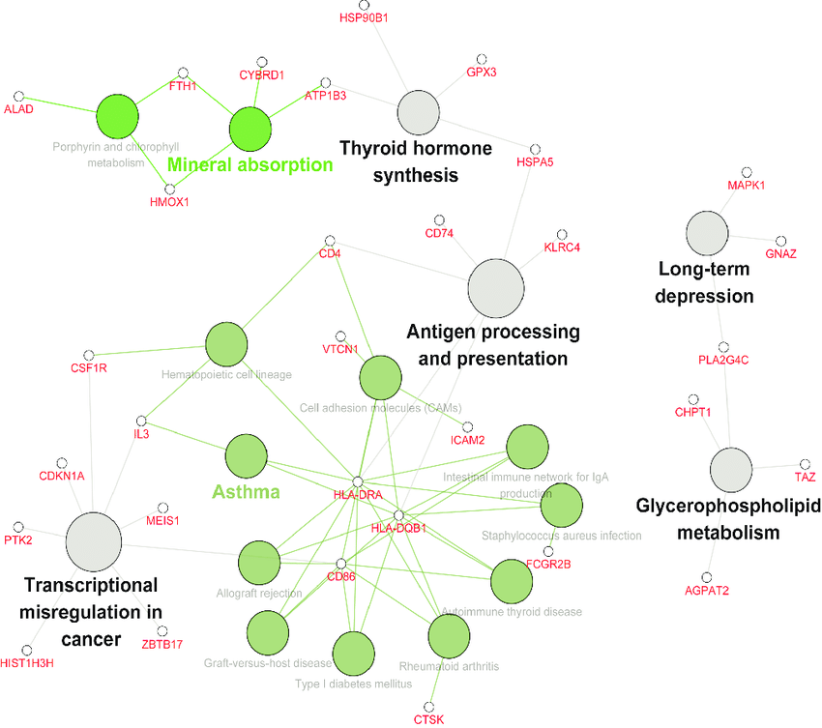
Next-gen sequencing
Benefits
  Unbiased measurement of processes in cells
  No predetermined pathways
  Organ and tissue responses
  Provide detailed analysis of pathways impacted
Drawbacks:
  Snapshot
  Not tied to final adverse outcome
  Large quantities of noisy data
  Not enough information for organisms of interest
Yoo et al., Nature Genetics, 2014
Xu et al. Experimental and Therapeutic Medicine, 2018

Slide 22
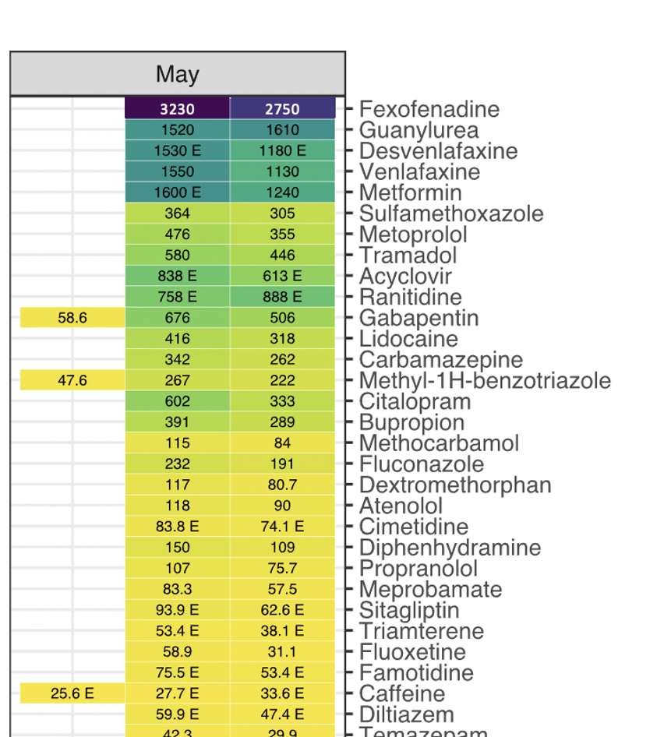



Linking Chemistry to Biological Effects in Real World
Dozens of CECs
Clear effluent impacts
Wastewater dominated stream
Novel pathways provide insights into mixture impacts and new biomarkers for indicators of exposure and effect
Meade et al. In review
Notes:
Examine chemistry upstream and downstream from WWTP
See differences in response?
What pathways associated with that response?
Are they linked to known modes of action of chemicals
Are there new genomic signatures that point to unmeasured impacts/new biomarkers

Slide 23





Other research at Freshwater Sciences
Ecosystems
Environmental
Health
Atm Sci &
Climate
Environmental
intelligence
Aquaculture

Slide 24




https://www.dhs.wisconsin.gov/covid-19/wastewater.htm#wastewater
Notes:
Potential = early warning and non-invasive monitoring for diseases. Are also studying the microbiome of sewar systems – potential source of antibiotic resistant bacteria

Slide 25



changing climate
2016
2020
7 hottest
2019
2015
2018
Data: NASA

Slide 26



+ 4-9 F. hotter
by 2090
warmer
nearly 2 months over 90º
+ 10-20% increase in ppt
wetter
50-100% increased freq intense events
D. Lorenz UW-Madison
Notes:
L Superior – water temps rising 2x air temps – offshore L Mich >80 F – unheard of

Slide 27

Extreme precipitation events,
US trend
Milwaukee River
discharge

Slide 28








Data Highlight
Lake Express Ferry Observing System
Data is essential
The monitoring system deployed on the Lake Express high-speed ferry allows for measurement of surface CO₂ concentrations and temperatures across the entire lake from east to west with high spatial and temporal resolution. The above measurements were made in spring, when nearshore warming resulted in high CO₂ partial pressure on both sides of the lake, but river loading of nutrients resulted in CO₂ concentrations well below saturation very close to the eastern shore, due to phytoplankton photosynthesis.
Measurements of Lake Michigan surface CO₂ partial pressure throughout the stratified period indicate that the lake is supersaturated with CO₂ until mid-July, after which it becomes under-saturated. When combined with measurements of wind speeds, these measurements are used to estimate CO₂ flux between the lake and the atmosphere, which serves as an indicator of lake productivity. Multi-year measurements indicate that the lake productivity can vary several-fold between years. When combined with weather data and other measurements made by the monitoring buoys, this information is allowing us to better understand the factors and mechanisms that regulate lake productivity.
Figures and photos courtesy of H. Bootsma and lake-express.com

Slide 29




+
Atmospheric Sciences
Major, Minor, Master's, Doctoral
Freshwater Sciences
Major, Minor
MMDS supported new position in Climate and Watersheds
$800K over 4 years

Slide 30



developing science-based policy solutions
to regional, national & international water resource issues
Melissa Scanlan Professor, Lynde B. Uihlein Endowed Chair and Director, Center for Water Policy
established in 2012 by endowment from the Brico Fund
with additional support from the Brookby & Daniel M Soref Foundations

Slide 31






Acknowledgments
Funding
  UWM Research Growth Initiative
  Wisconsin Sea Grant

