Slide 1
April 18, 2023
NAHEFFA Spring Conference
Liz Clark
Vice President, Policy and Research
lclark@nacubo.org

Slide 2
The 118th Congress
Democrat
Republican
Independent
HOUSE
SENATE
435 Seats
218 Votes for Majority
51 Votes for Majority*
Vacancies: VA-4
Vacancies: NE-II
*Independent Senators Sanders (I-VT) and King (I-ME) counted as Democrats; Independent Senator Kirsten Sinema (I-AZ) not counted as a Democrat
SOURCE Associated Press
SLIDE LAST UPDATED ON 1/17/23
Notes:
Ashley

Slide 3
President Biden's FY 2024 Budget Request
March 9, 2023
Proposes raising the maximum Pell Grant award to $8,215 for the 2024-2025 academic year
$500 million for a new discretionary grant program that will provide two years of free postsecondary education at high-quality community colleges that lead to good-paying employment or four-year degrees
$30 million for Postsecondary Student Success Grants
Increases institutional capacity at HBCUs, TCCUs, MSIs, and low-resource institutions, including community colleges, by $429 million over the fiscal year 2023 authorized level
$178 million for ED’s Office of Civil Rights (27 percent increase)
Notes:
Ashley

Slide 4
Research Funding in WH Budget Request
Dept. of Energy: $35m to start process of standing up a new national lab at an HBCU or MSI
National Science Foundation: 18.6 percent increase
Dept. of Agriculture: $95m increase to Agriculture and Food Research Initiative
Health and Human Services: Agency increase of 11.5 percent;
$1 billion increase for Advanced Research Projects Agency for Health (ARPA-H)
NASA: 7 percent increase for the agency
Notes:
Liz

Slide 5
Must Pass Legislation by September 30, 2023
Debt Ceiling
FY24 Appropriations
Farm Bill
FAA Reauthorization
Notes:
Ashley

Slide 6
In the Courts
Notes:
Ashley to cover slides; Liz to add color commentary

Slide 7
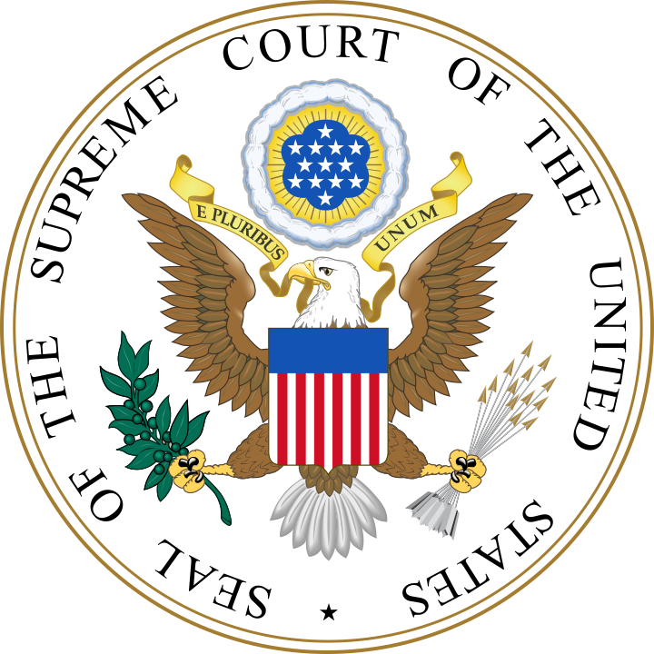
Admissions Practices: Students for Fair Admissions Inc. v. President & Fellows of Harvard College
Background
In 2014, Students for Fair Admissions (SFFA) filed suit against Harvard University and University of North Carolina, alleging that their affirmative action policies violate the Civil Rights Act of 1964
Legal Context
In 2003, the Supreme Court ruled by a 5-4 majority that universities may use race-conscious admissions policy in order to contribute to a more diverse student body in Grutter v. Bollinger
The Court reaffirmed this decision in 2016 with a 4-3 vote in Fisher v. University of Texas, but the composition of the court has grown markedly more conservative since then

Slide 8
Admissions Practices: Students for Fair Admissions Inc. v. President & Fellows of Harvard College, Cont.
Potential Implications
A ruling in favor of SFFA could undo decades of precedent holding that affirmative action policies are constitutional
Universities with such policies may be compelled by the Court to reverse their stance
Arguments were delivered 10/31/22 to a Court that appears more receptive to revisiting precedent than that which decided Bollinger and Fisher II

Slide 9
Student Debt Relief
Background
In August 2022, Biden announced a student loan forgiveness plan
In the time since the announcement, the administration has approved 16 million applications for forgiveness
Two cases before the Supreme Court
Biden v. Nebraska
Forgiveness causes financial harm to states and state authorized loan collectors
ED lacks the authority to forgive this debt
Department of Education v. Brown
Certain borrowers were arbitrarily excluded from forgiveness
The administration did not allow proper opportunity for comment

Slide 10
Student Debt Relief, Cont.
The latest
No mention of loan forgiveness in President Biden’s State of the Union Address
Administration has said it is not working on alternative plans
End of national emergency announced
Stakeholders weighing in on both sides
SCOTUS heard oral arguments on February 28
Upcoming
A decision is expected in late June
Continued debate around Washington

Slide 11
Department of Education
Notes:
Ashley on TPS, Liz on other slides

Slide 12
Upcoming Negotiated Rulemakings
This is the process where ED writes/updates its regs
Final rules have to be published by Nov. 1 in order to become effective July 1 of the following year
On ED’s list:
Federal TRIO Programs
Accreditation and Related Issues
State Authorization
Return to Title IV
Cash Management
Third-Party Servicers and Related Issues
Improving use of Deferments and Forbearances
Distance Education
Notes:
Liz

Slide 13
Expected Proposed Rules
Ability to Benefit
Gainful Employment
Financial Responsibility
Administrative Capability
Certification Procedures
Title IX Rules
PLUS: Implementation of FAFSA simplification
Notes:
Liz

Slide 14
DOL Overtime Rule
Department of Labor to Revisit Salary Threshold
From 1938 to 1975, DOL updated the minimum salary level every five to nine years. Prior to 2019, the last update to the minimum salary level was in 2004, or 15 years prior.
Notes:
Liz

Slide 15
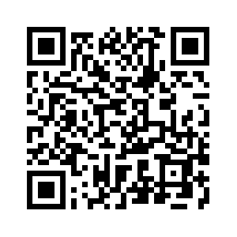
More Is Possible With Higher Education
More opportunities
More prosperity
More community benefits
More support
More work to be done
Notes:
Liz

Slide 16
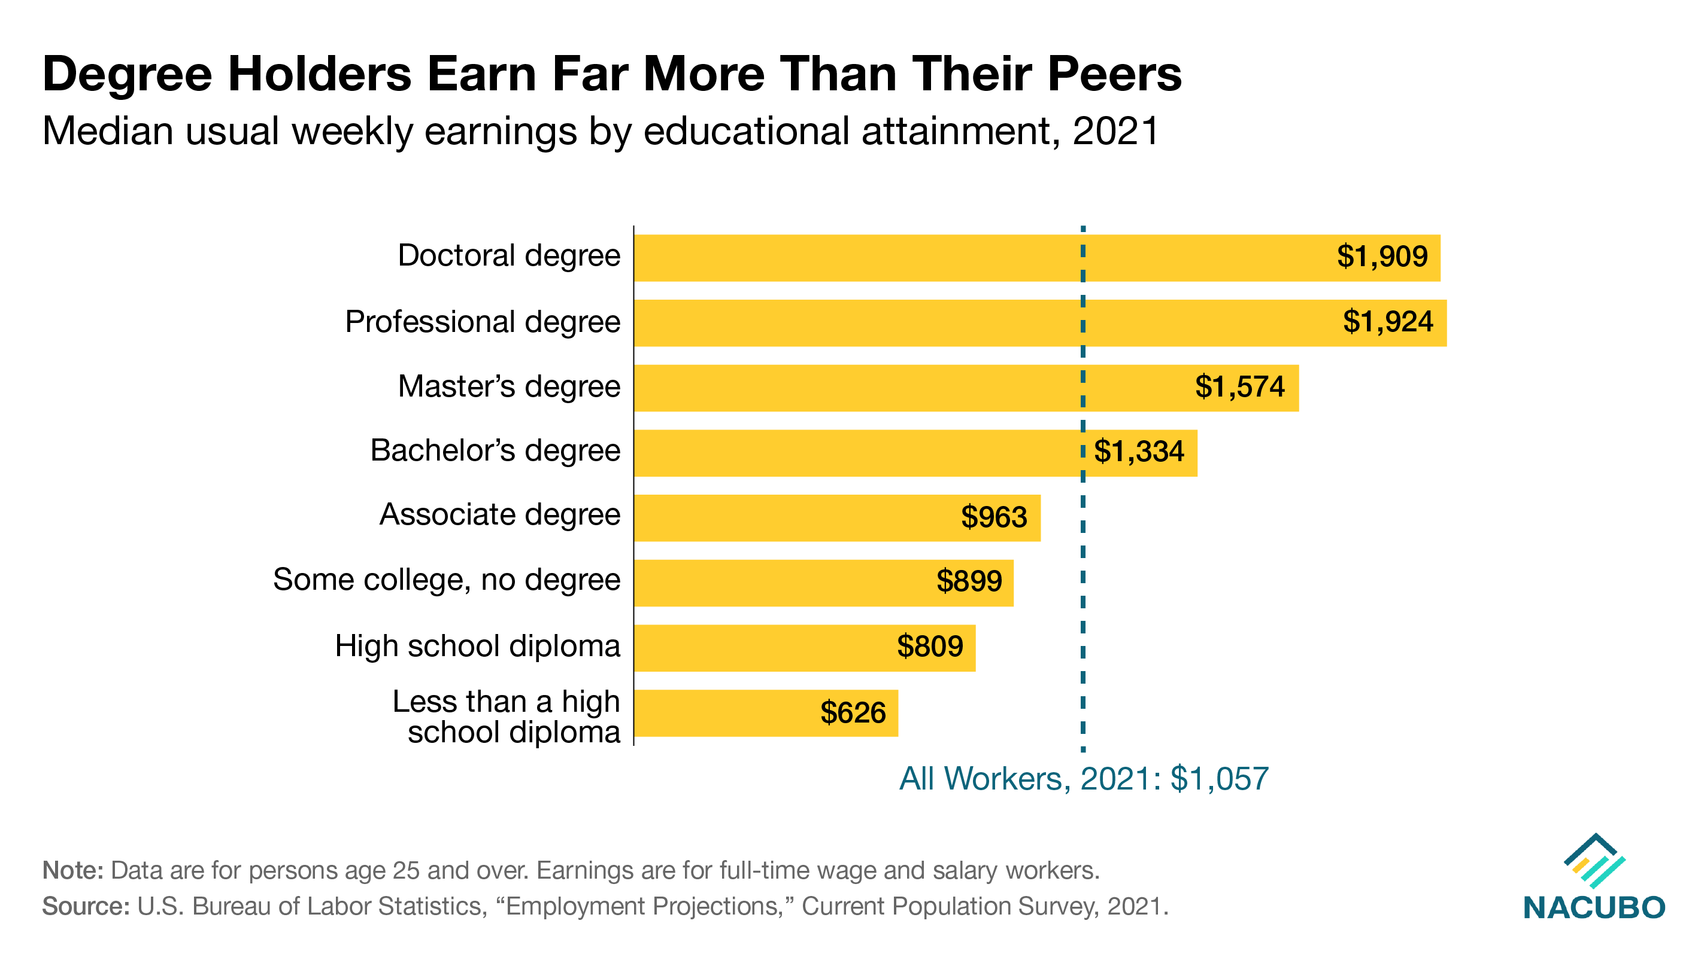

Slide 17
